Slide 1
Graph Cuts for Skull Stripping
Ahsan Mahmood

Slide 2
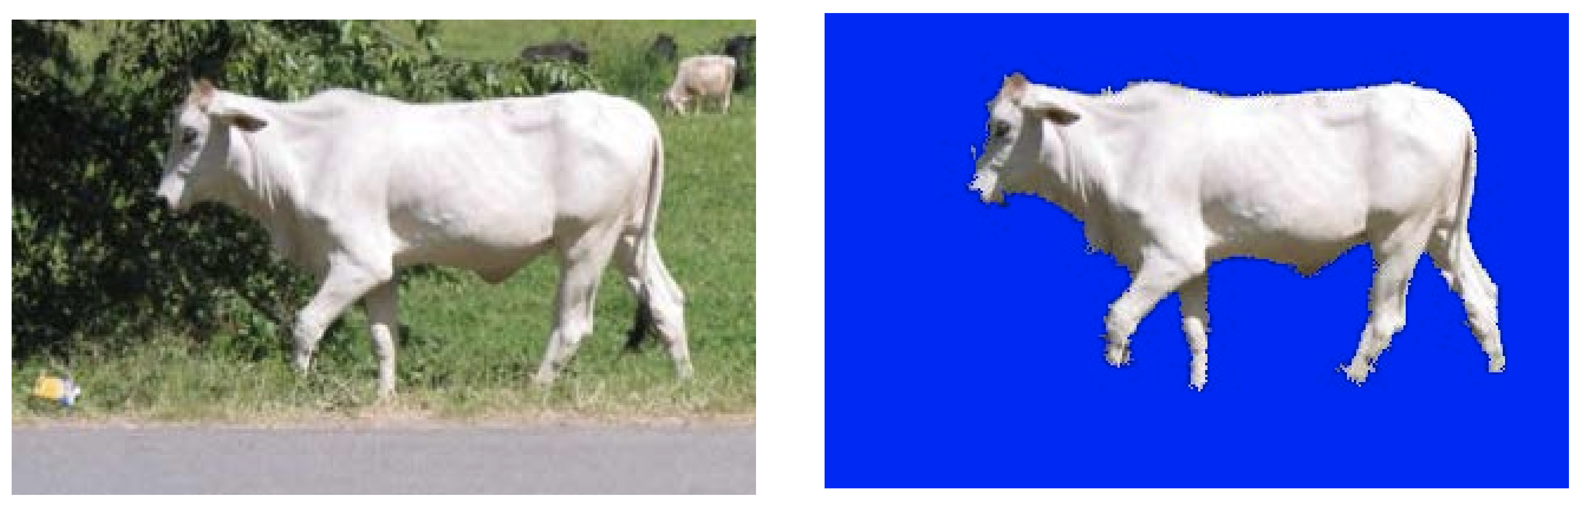
Binary Segmentation

Slide 3
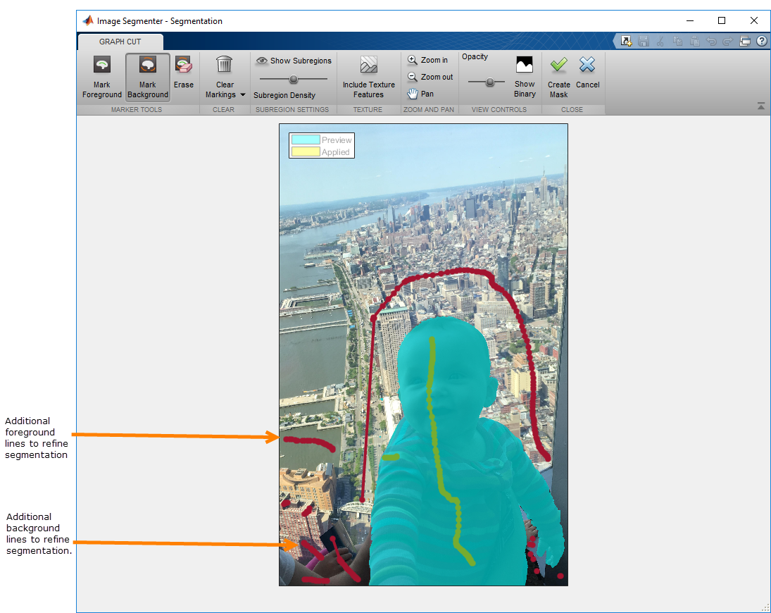
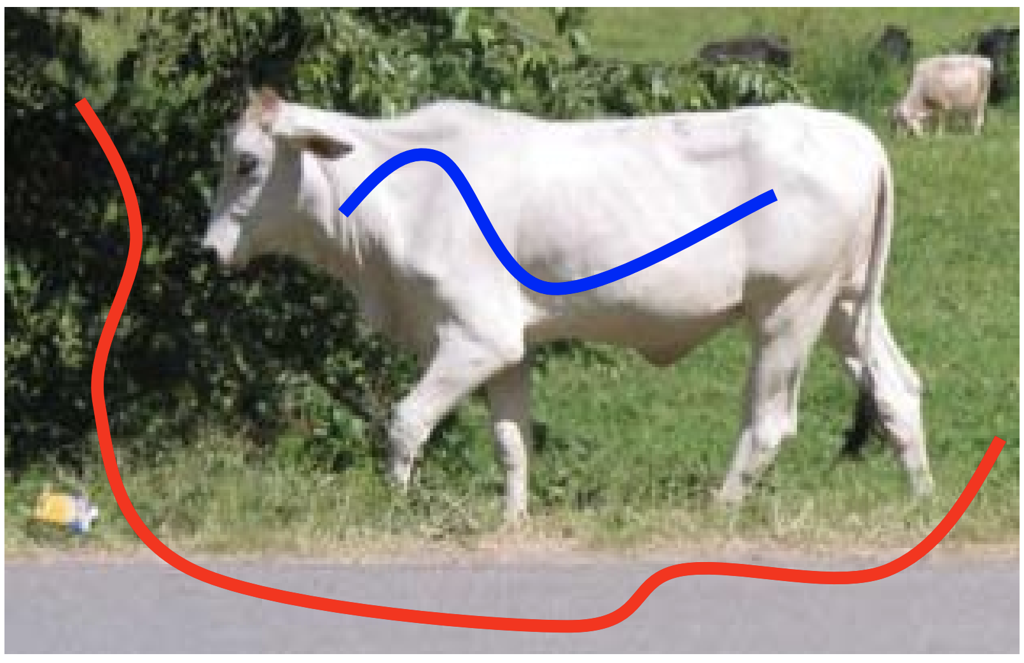
Graph Cuts

Slide 4
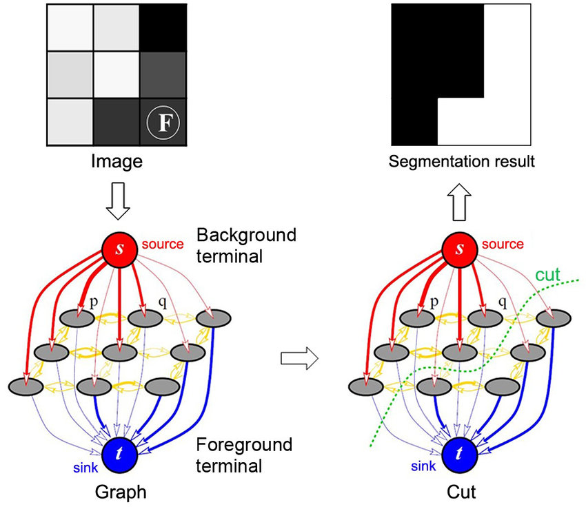
Graph Cuts

Slide 5
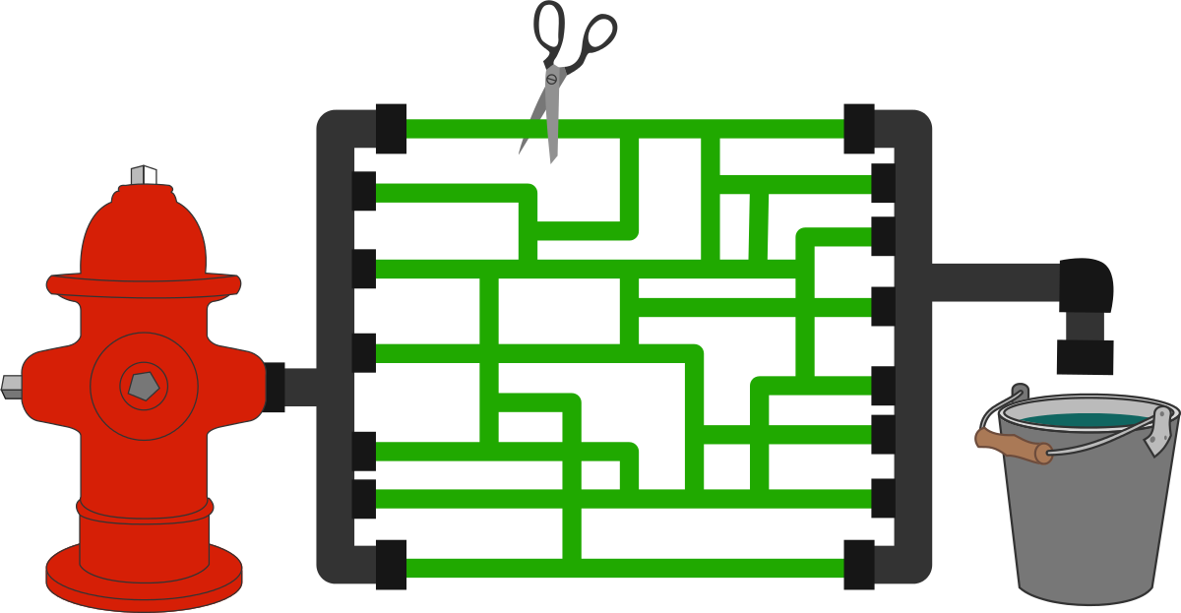
Maxflow
The max-flow min-cut theorem states that in a flow network, the maximum amount of flow passing from the source to the sink is equal to the total weight of the edges in the minimum cut
Cut: Edges which if removed would disconnect the source from the sink

Slide 6
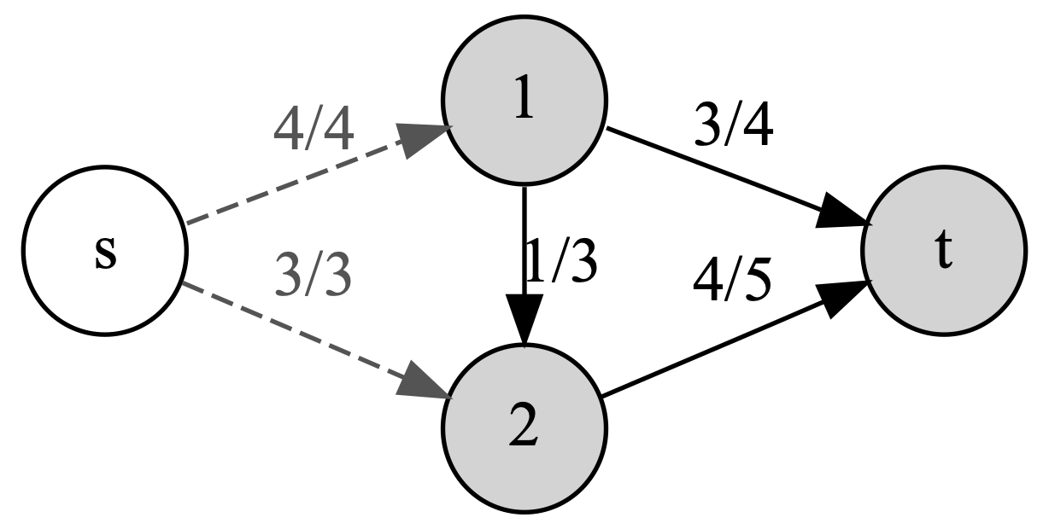
Maxflow

Slide 7
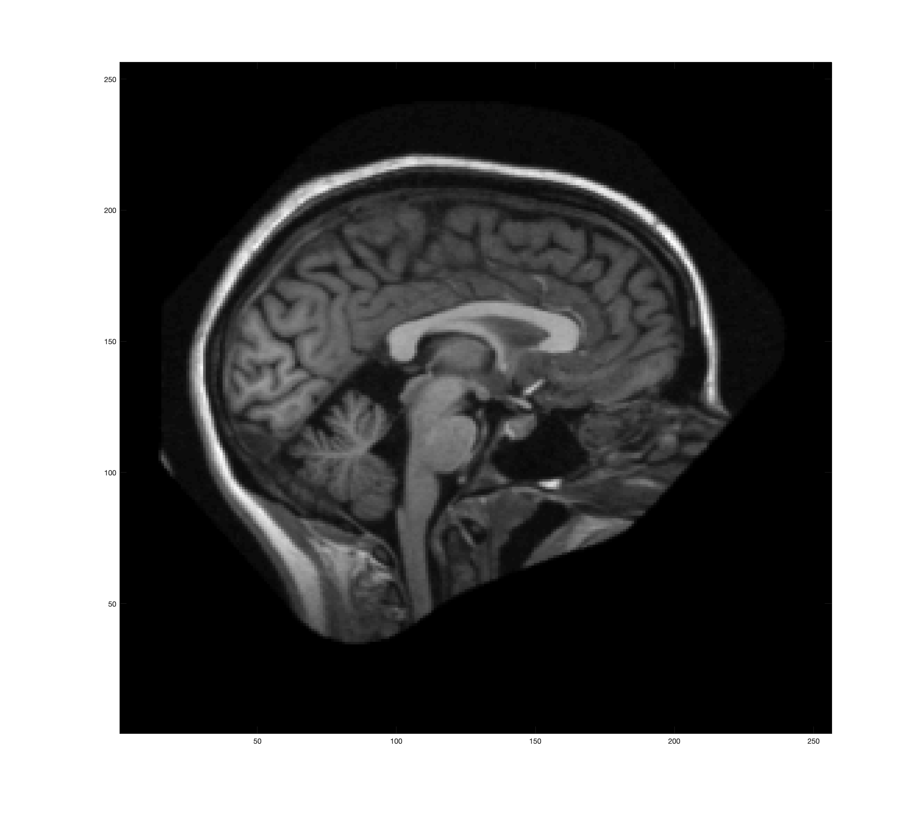
Data
T1 weighted MRI Images from assignment in BME 775
Sagittal sections
Corpus Callosum clearly visible

Slide 8
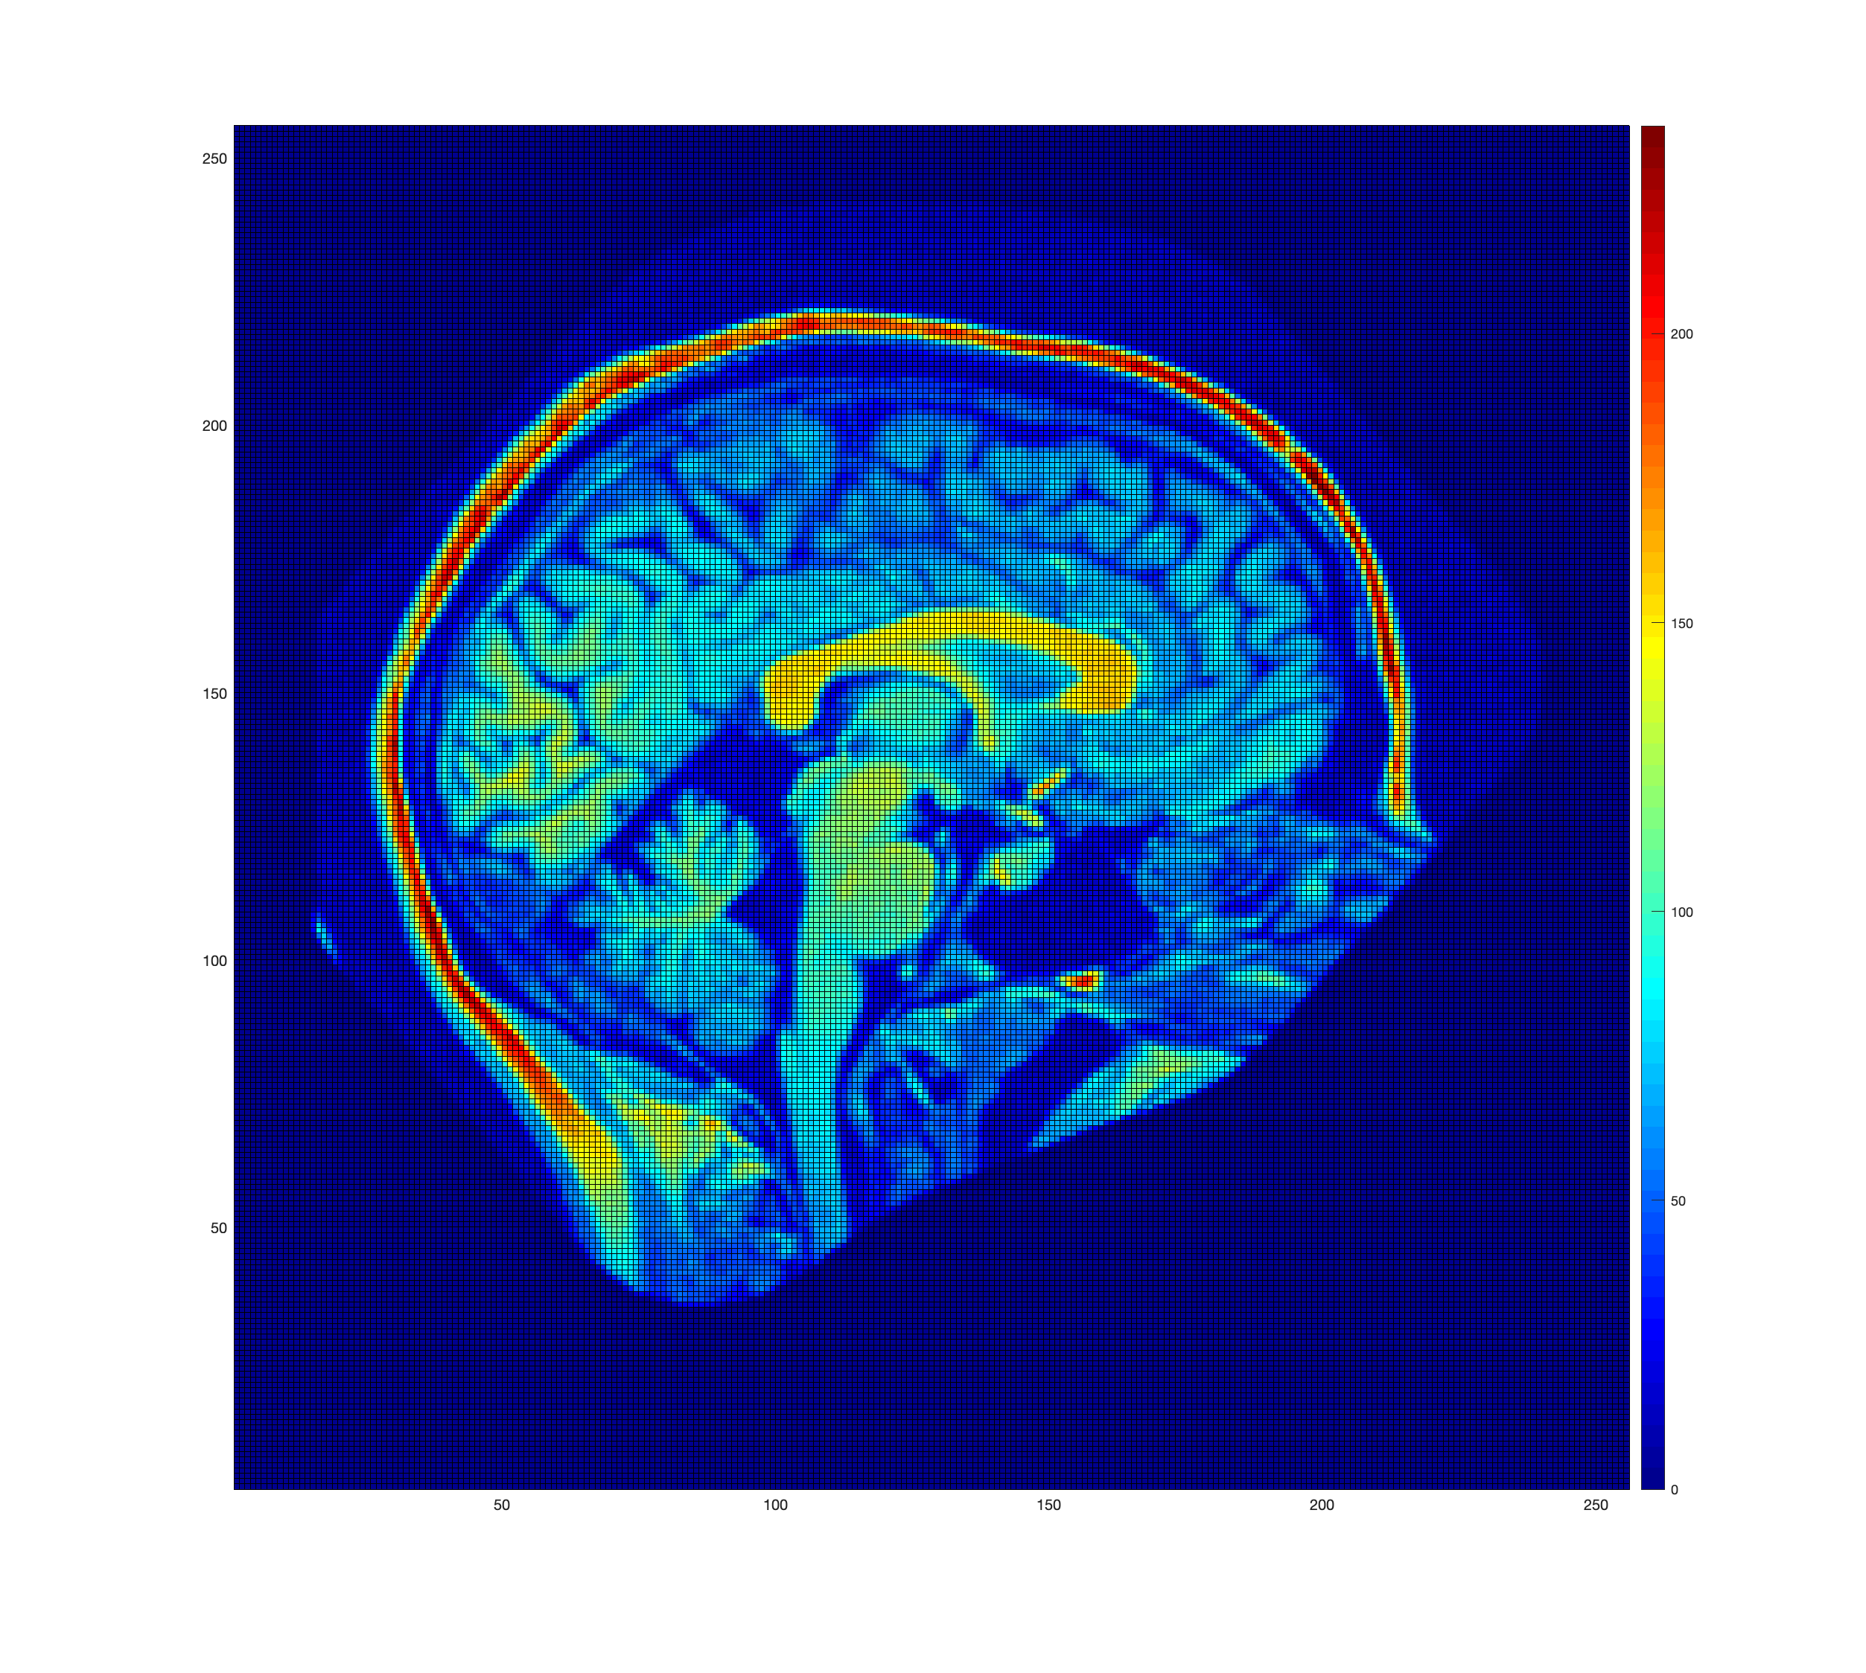
Data
Background noise
Used hard threshold to remove it
Some non-brain anatomical structures visible

Slide 9
Building Graph
Each pixel assigned a corresponding node
Each edge between pixels assigned a flow capacity
Created virtual source and sink
Source forward connected to pixels
Pixels forward connected to sink

Slide 10
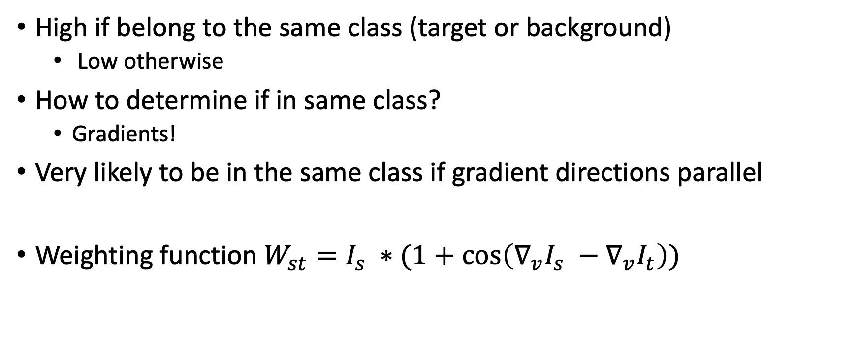
Pixel – Pixel Weights
High if belong to the same class (target or background)
Low otherwise
How to determine if in same class?
Gradients!
Very likely to be in the same class if gradient directions parallel
Weighting function $W_{st}=I_{s} ∗(1+\cos\left(∇_{v}I_{s} −∇_{v}I_{t}\right))$

Slide 11
Source/Sink – Pixel Weights
Source -> Pixel : high if background class
Pixel -> Sink: high if target class
How to tell if target or background?
Seeds!
What does “high” even mean?
I don’t know

Slide 12
Generating Seeds
Usually seeds added via user interaction
Automation would be nice
Use a heuristic inspired by thresholding and quantiles
Main Idea: Skull generally appears brighter than white matter
Get all pixels that fall within one standard deviation of the class mean

Slide 13
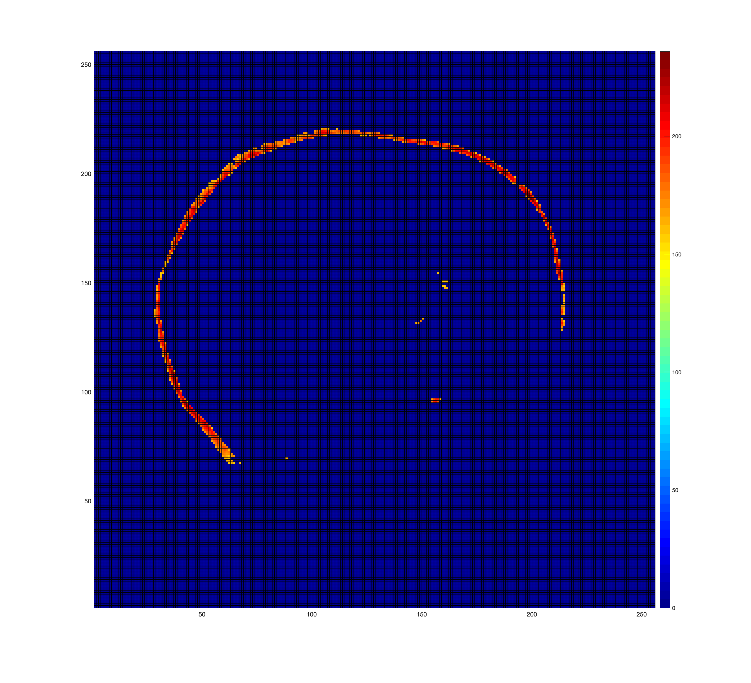
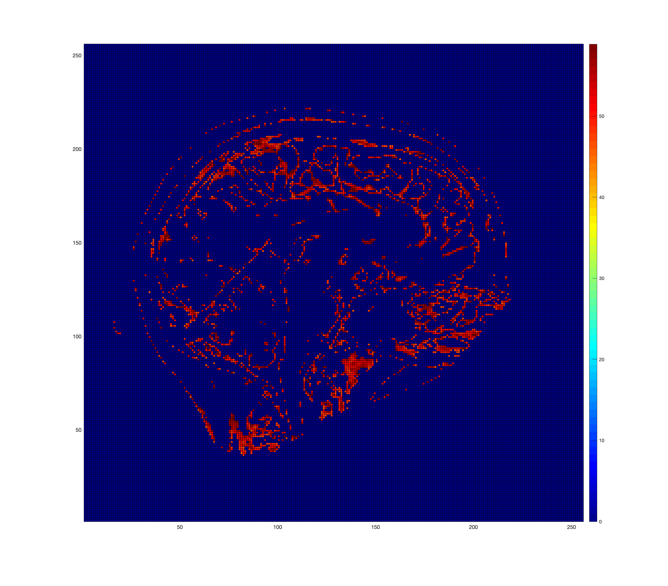
Generating Seeds
Used 98th percentile as a threshold for skull
Intensities between 50th and 70th percentile worked well for “white matter” class
Skull Seeds
“WM” Seeds

Slide 14
Strict Cutoff
Target is skull
Source -> Pixel: Only connected to background
If pixel intensity < target mean
Pixel -> Sink : Only connected if pixel is in target class
If pixel intensity > target mean
Weights to connected pixels: Intensities of the pixels
Not connected means edge weight is set to zero

Slide 15
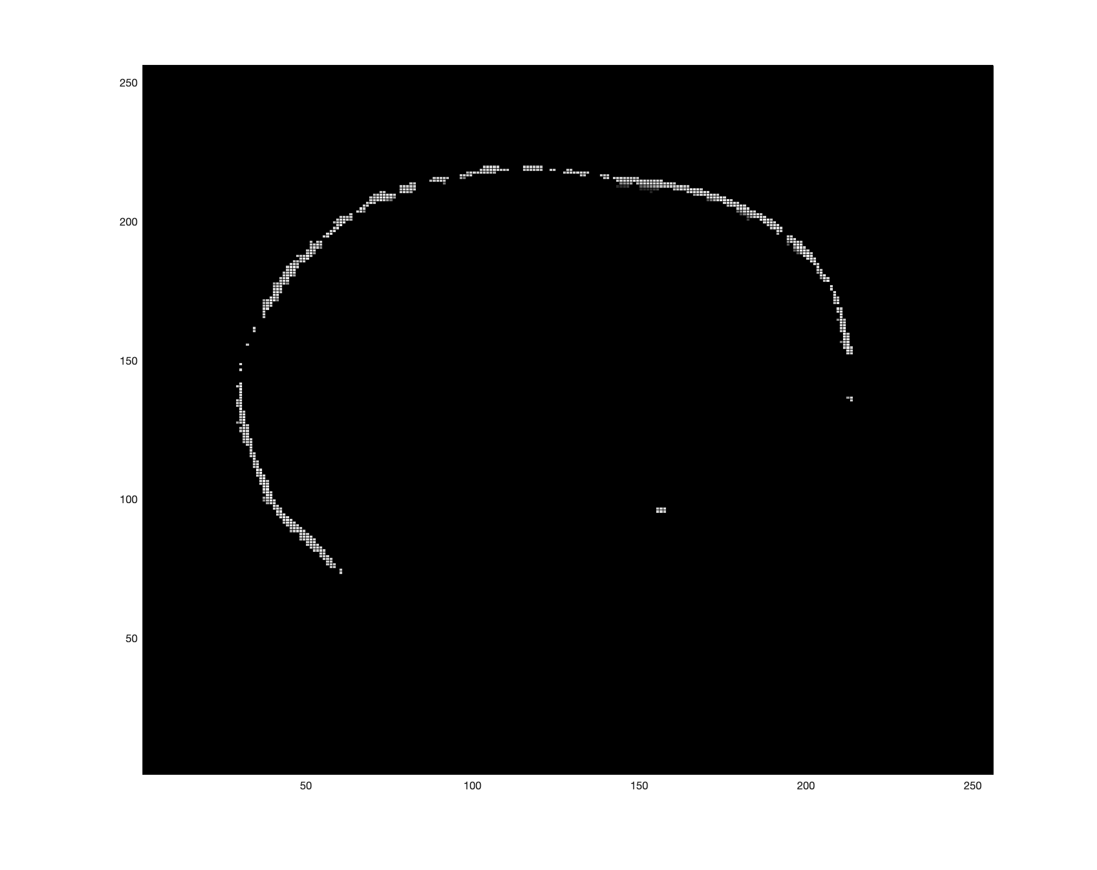
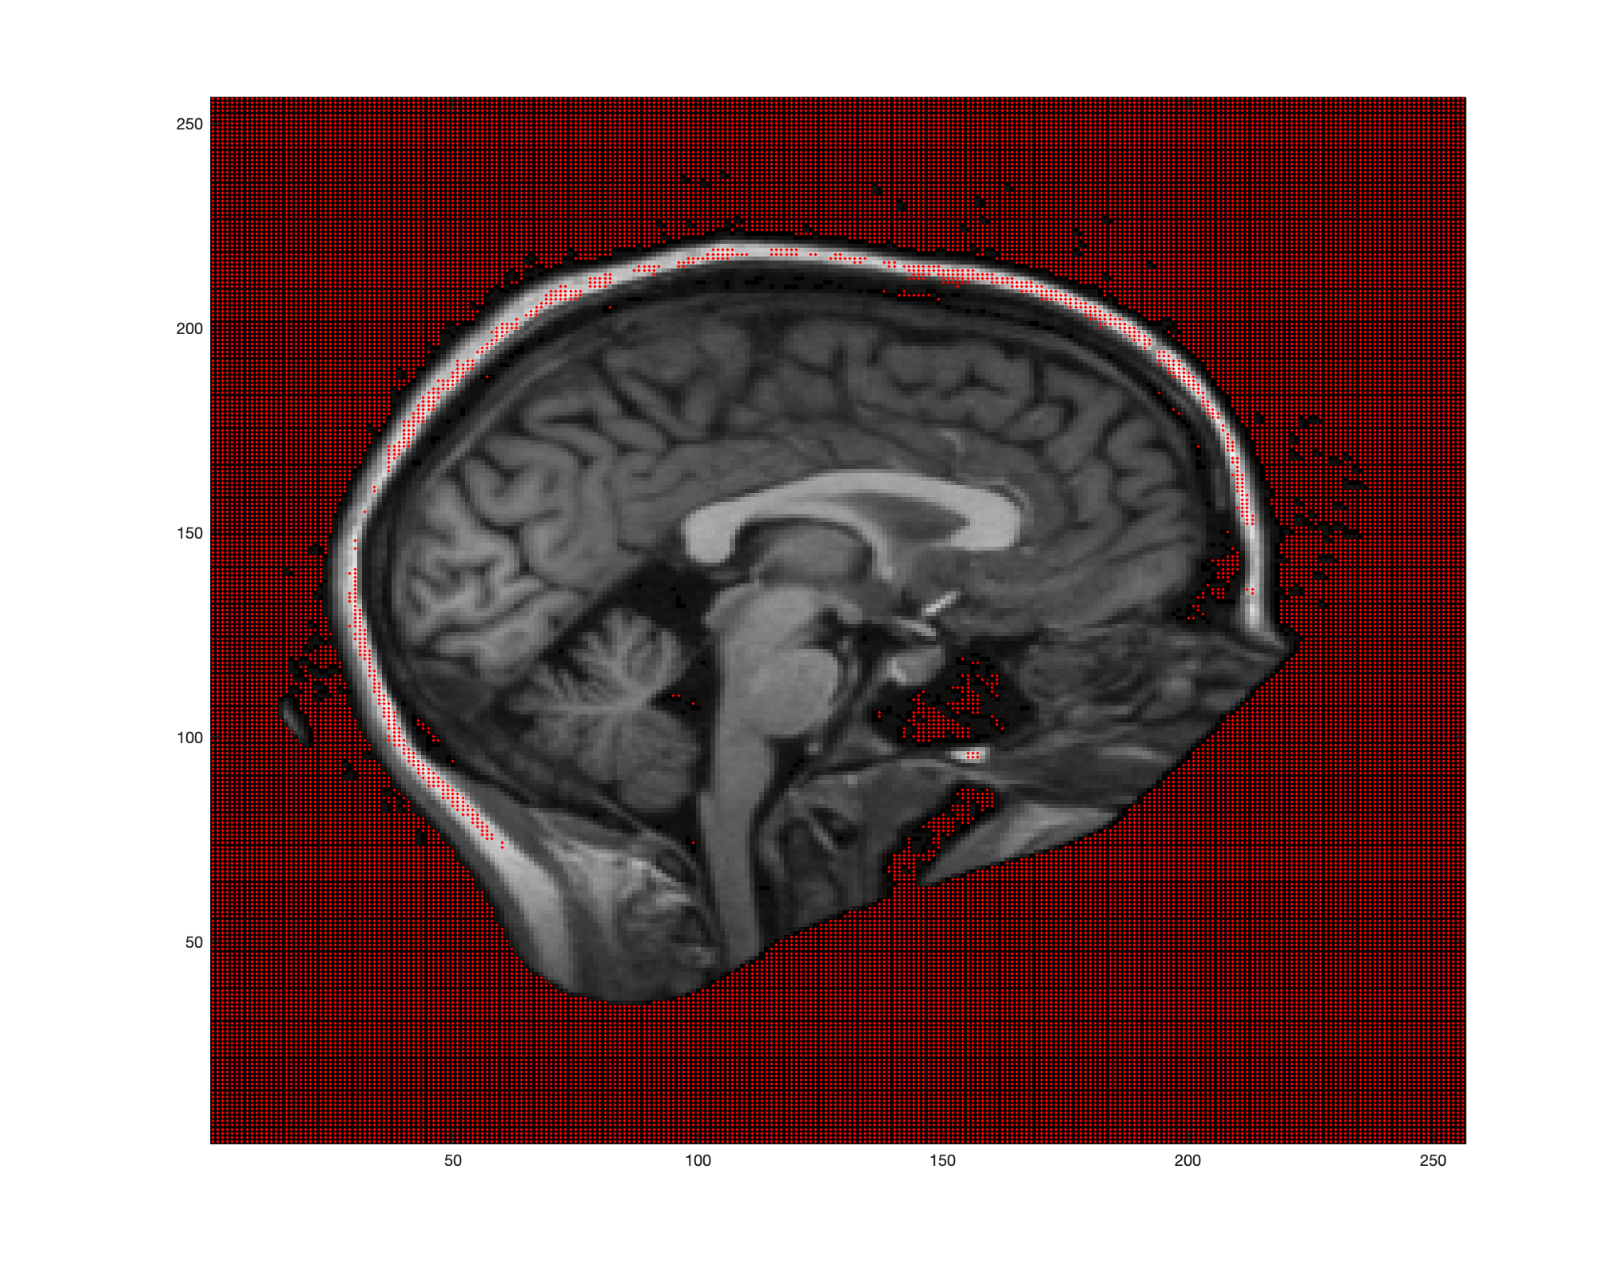
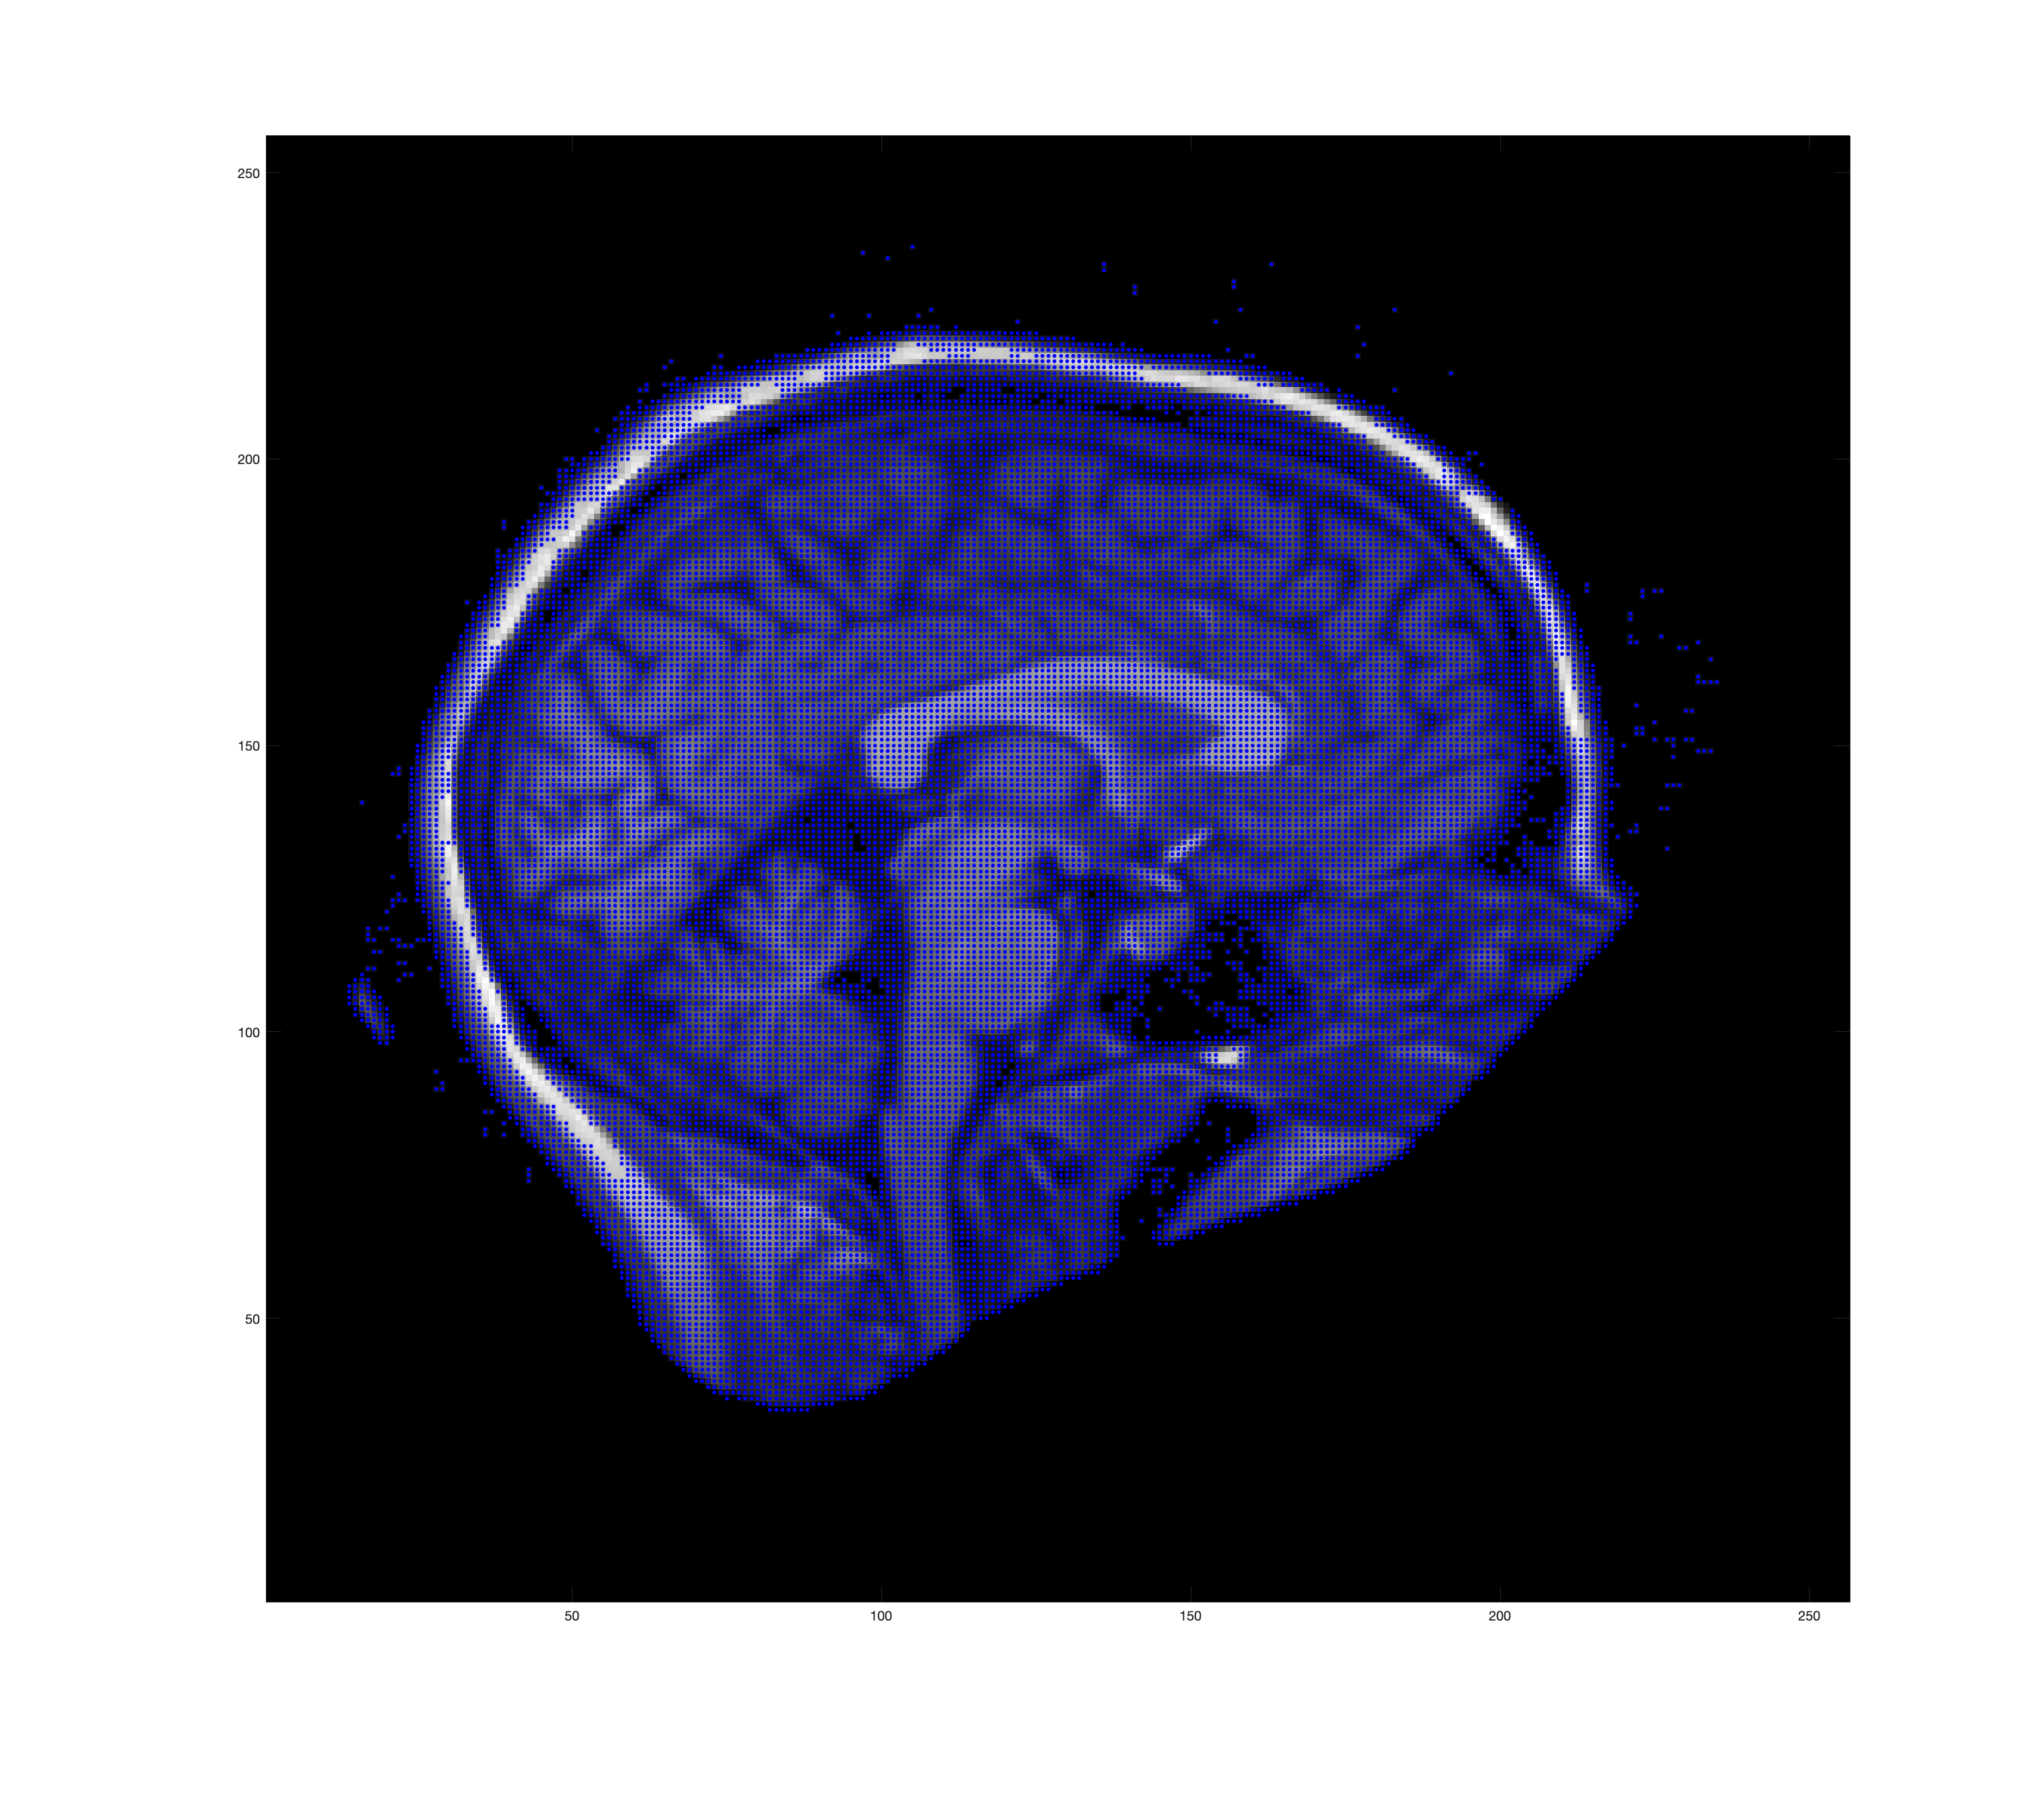
Strict Cutoff
Background Nodes
Foreground Nodes

Slide 16
Intensity Difference
Flow capacities should vary on a range
As the difference from the target class mean intensities change, so should the corresponding weights to source/sink.
Source/Sink connected to all pixels
Edge weights: Intensities weighted by squared difference from class mean
Other decays tended to over/undershoot
Background Class: Skull
Target Class: White Matter

Slide 17
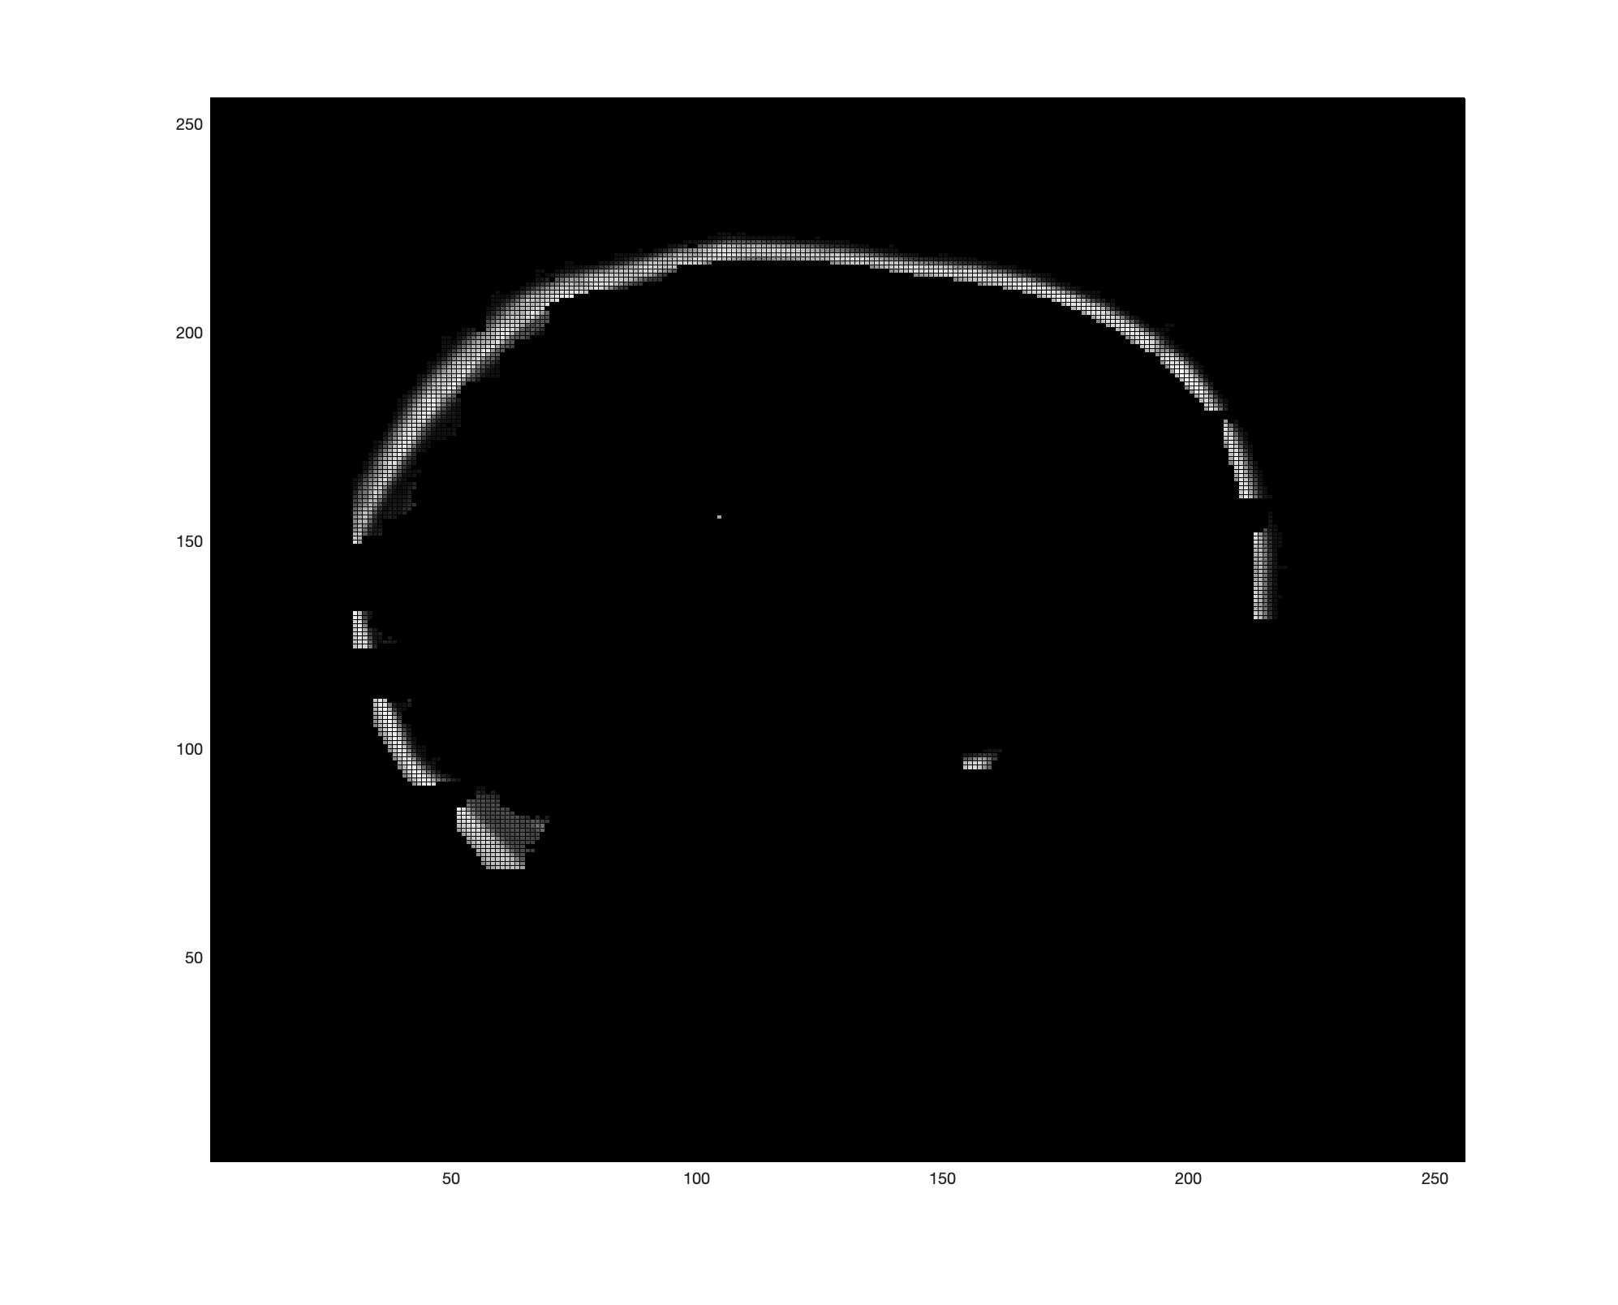
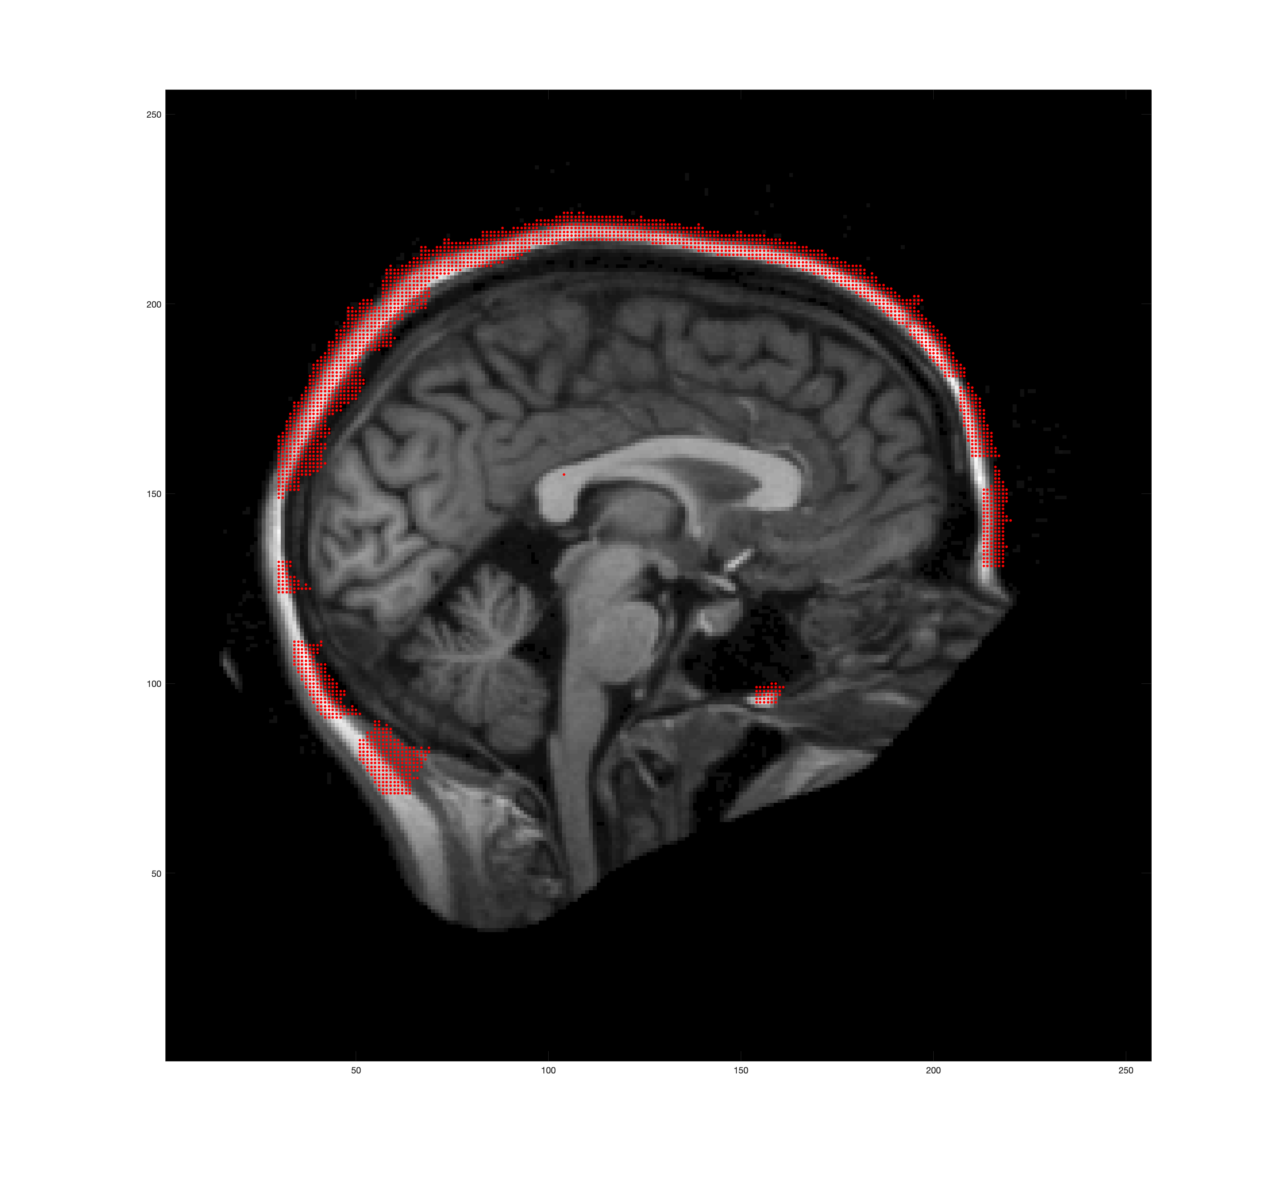
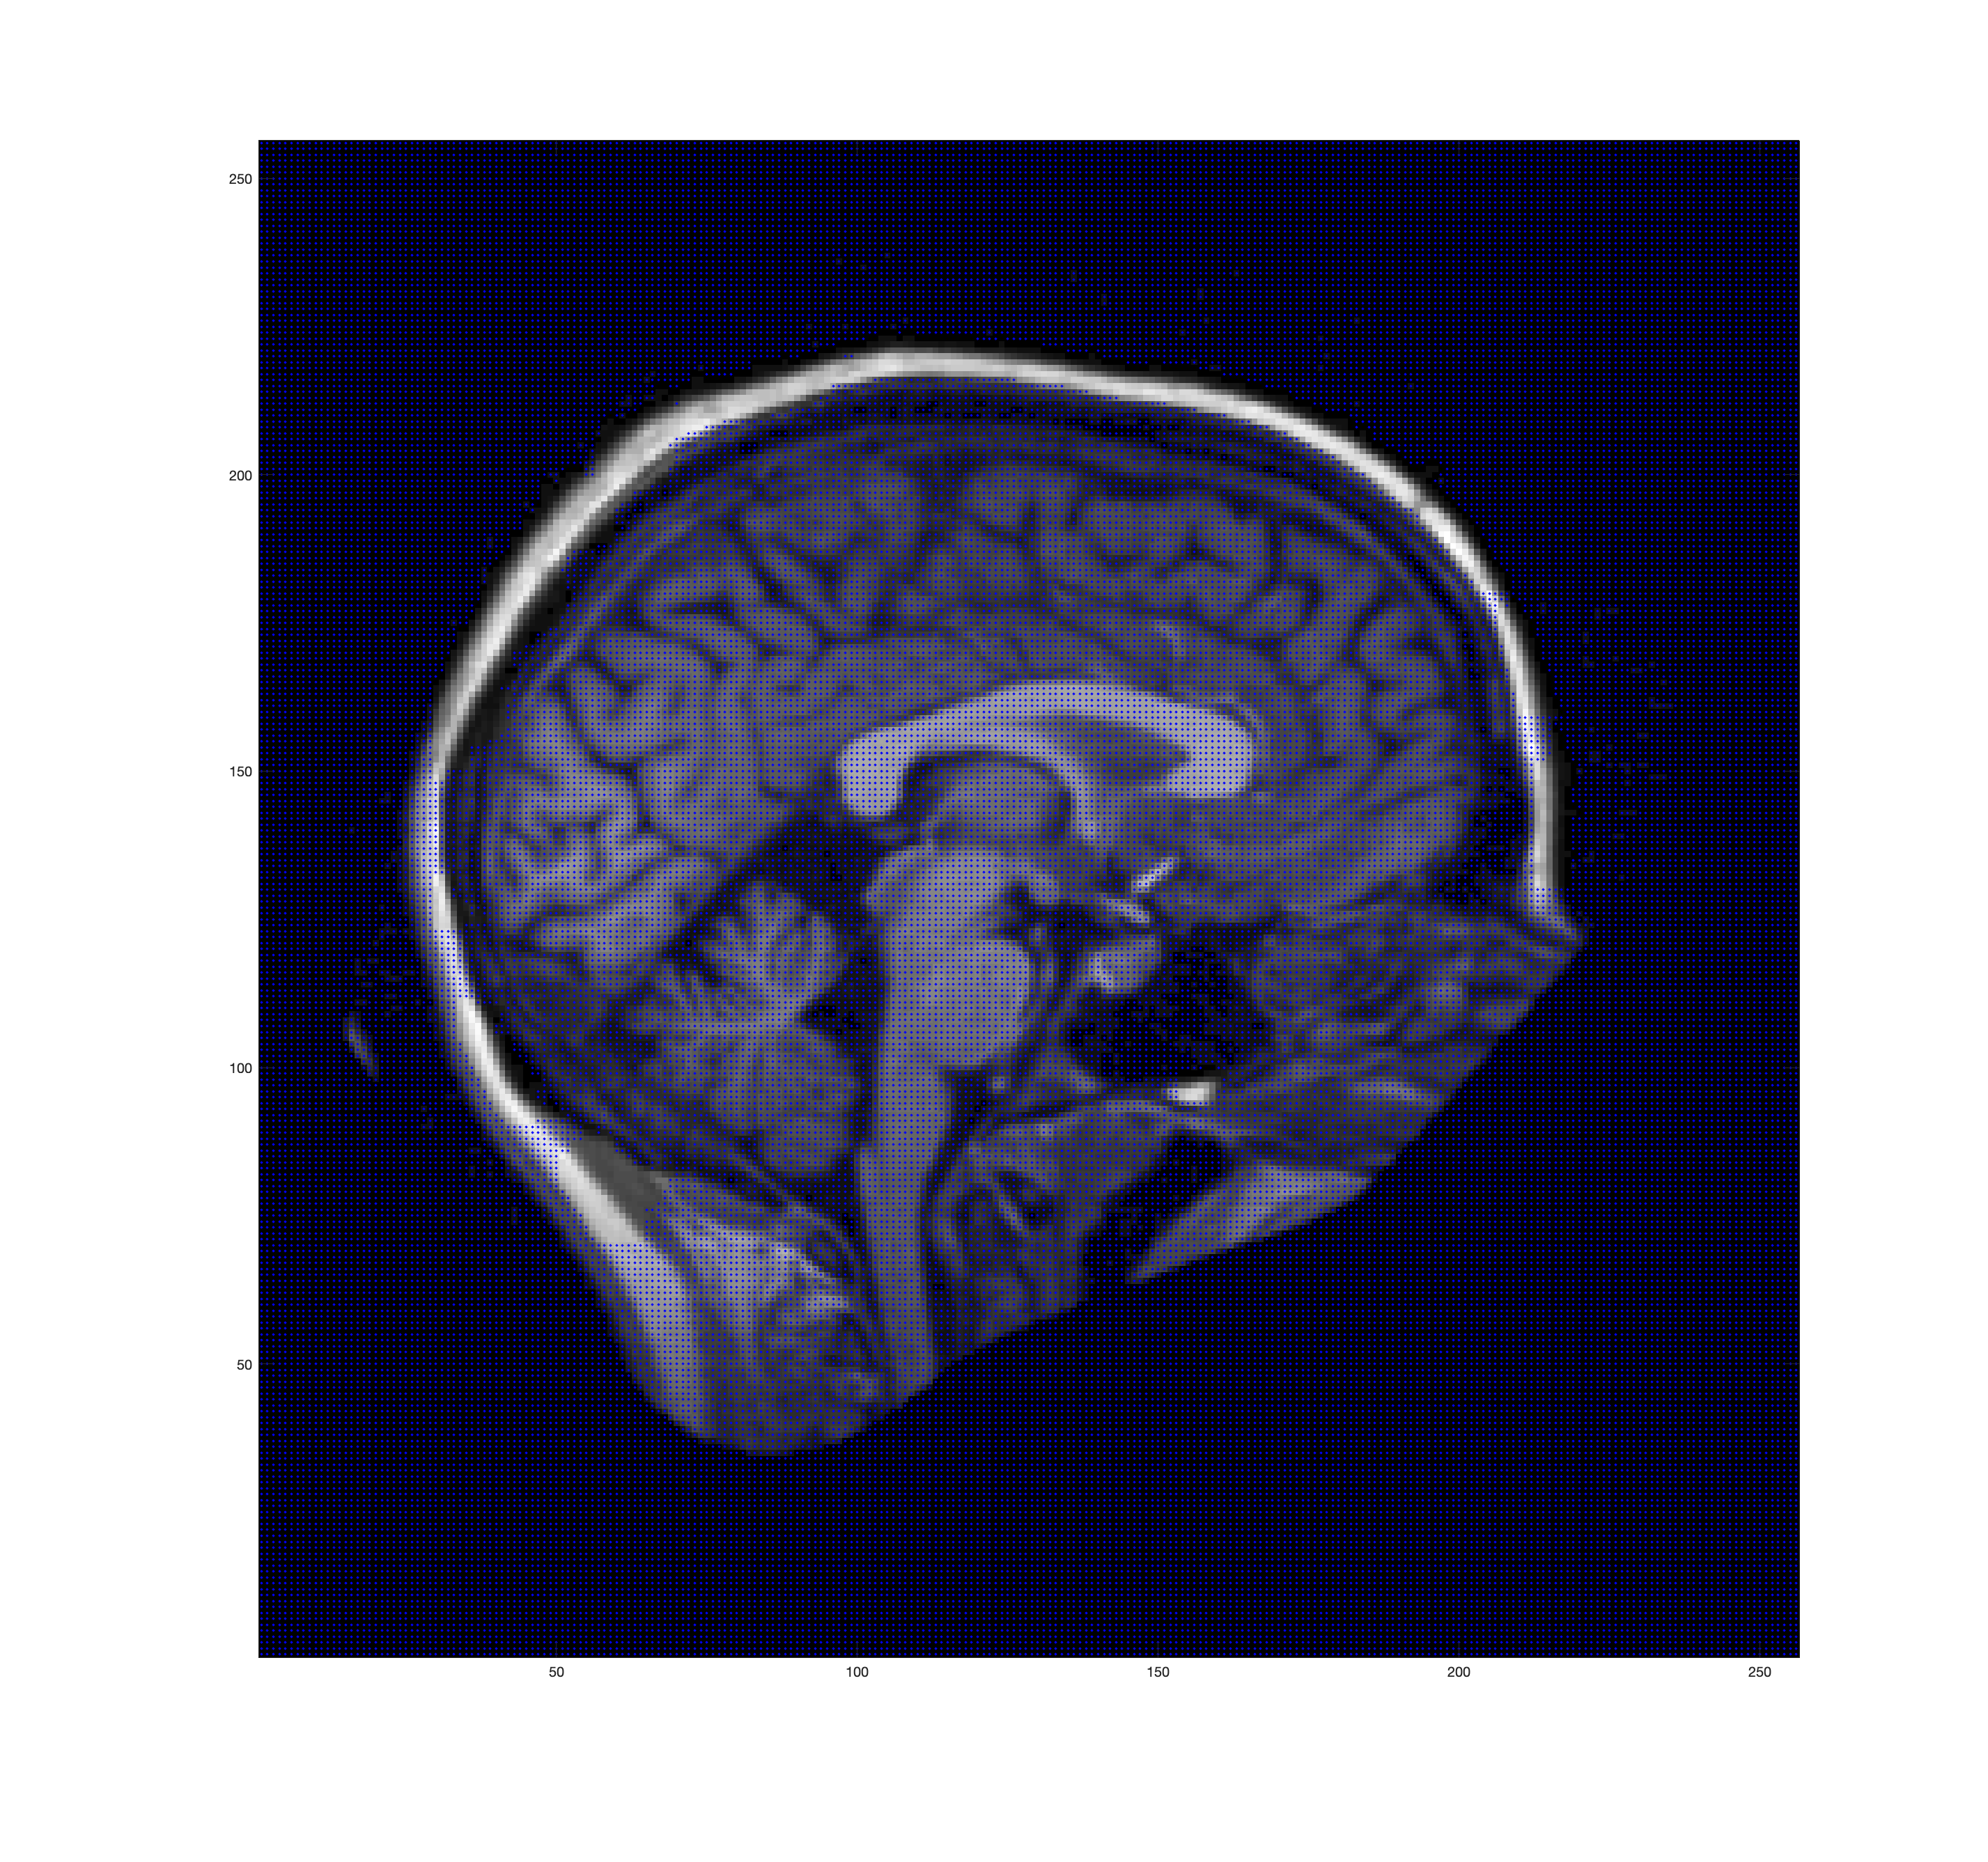
Intensity Difference
Background Nodes
Foreground Nodes

Slide 18
Hybrid Approach
Combines cutoffs based on classes and intensity differences
Source is only connected to background pixels (pixels lying outside the brain) and the skull seeds
The weights on these edges are set to the maximum flow value
Conversely the sink is only connected to non-background pixels
The weights for edges connecting white matter seeds are set to maximum
Other non-skull regions are weighed according to intensity differences from the white matter class mean

Slide 19
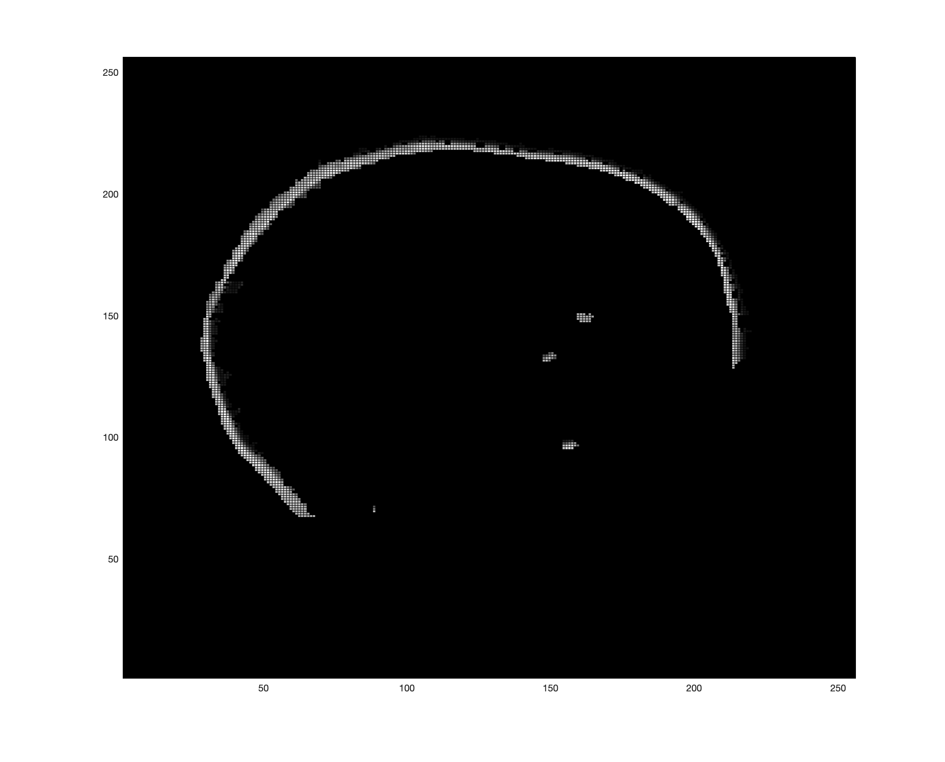
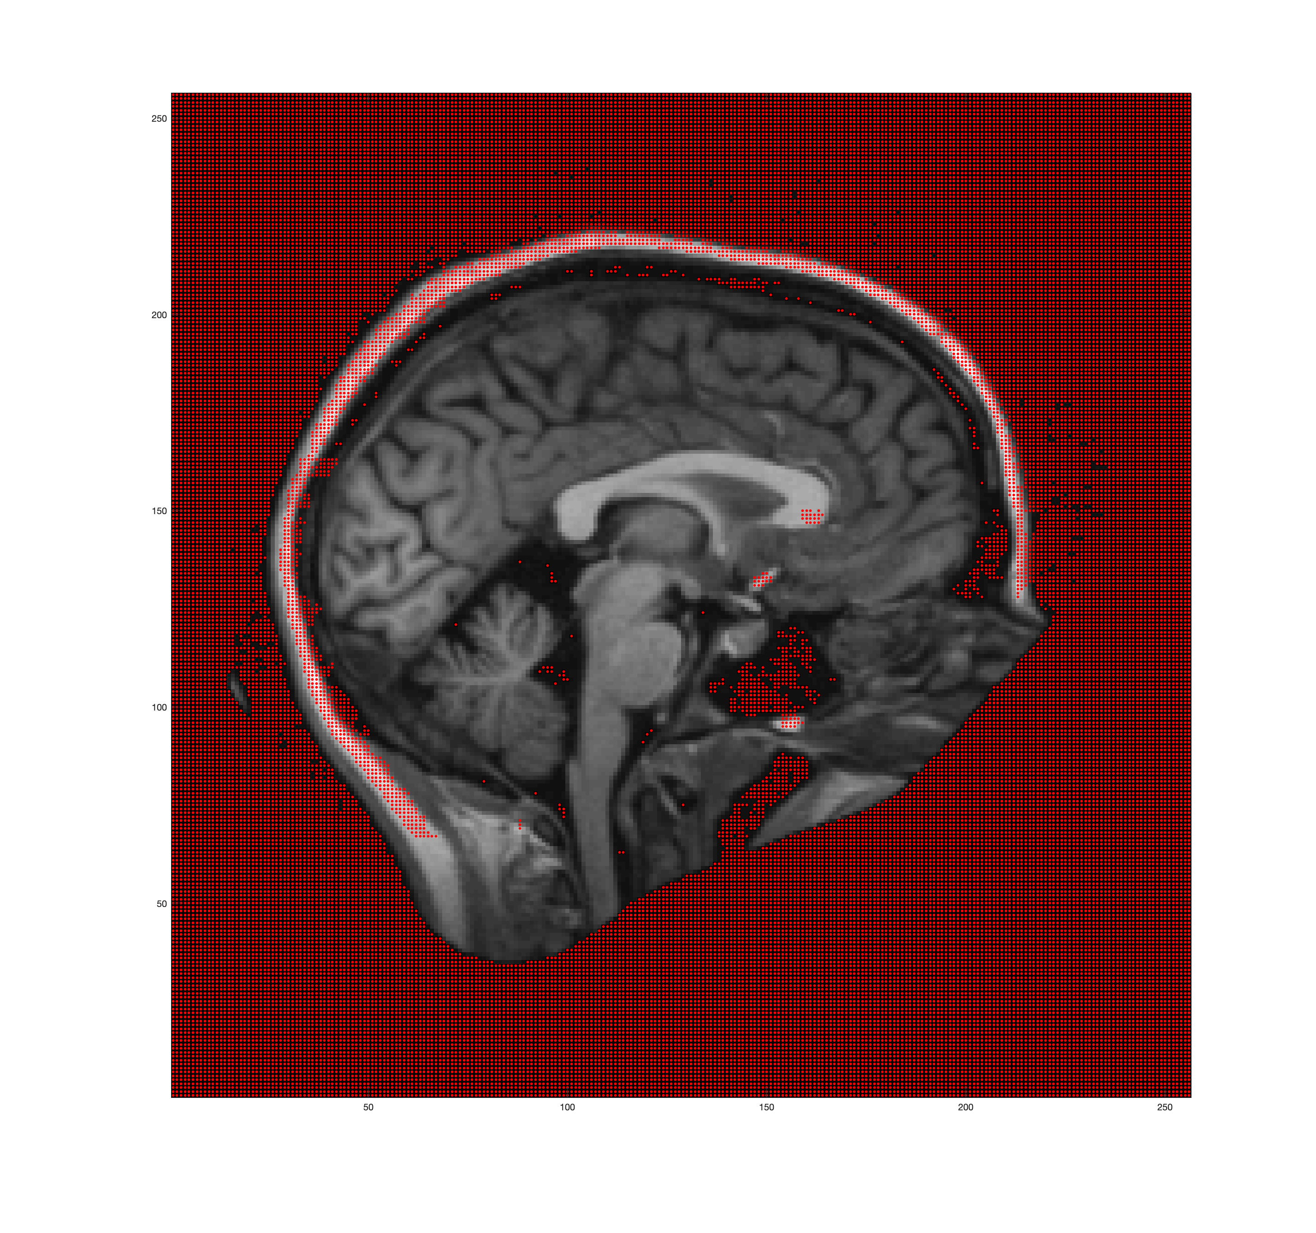
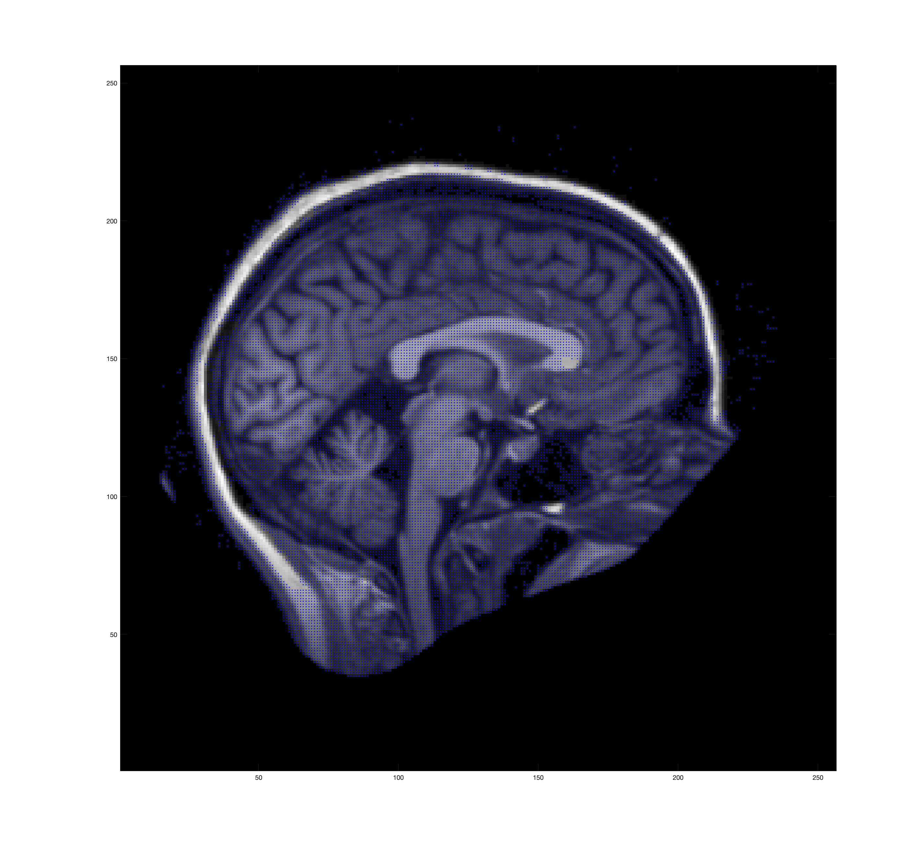
Intensity Difference
Background Nodes
Foreground Nodes

Slide 20
Pruning
An final optimization
Lots of background pixels (very low intensity)
Have high pixel-pixel weights
Algorithm wants to push flow through them and not the skull
Solution: DESTROY them
Remove pixel – pixel edges that are solely between very low intensity pixels

Slide 21
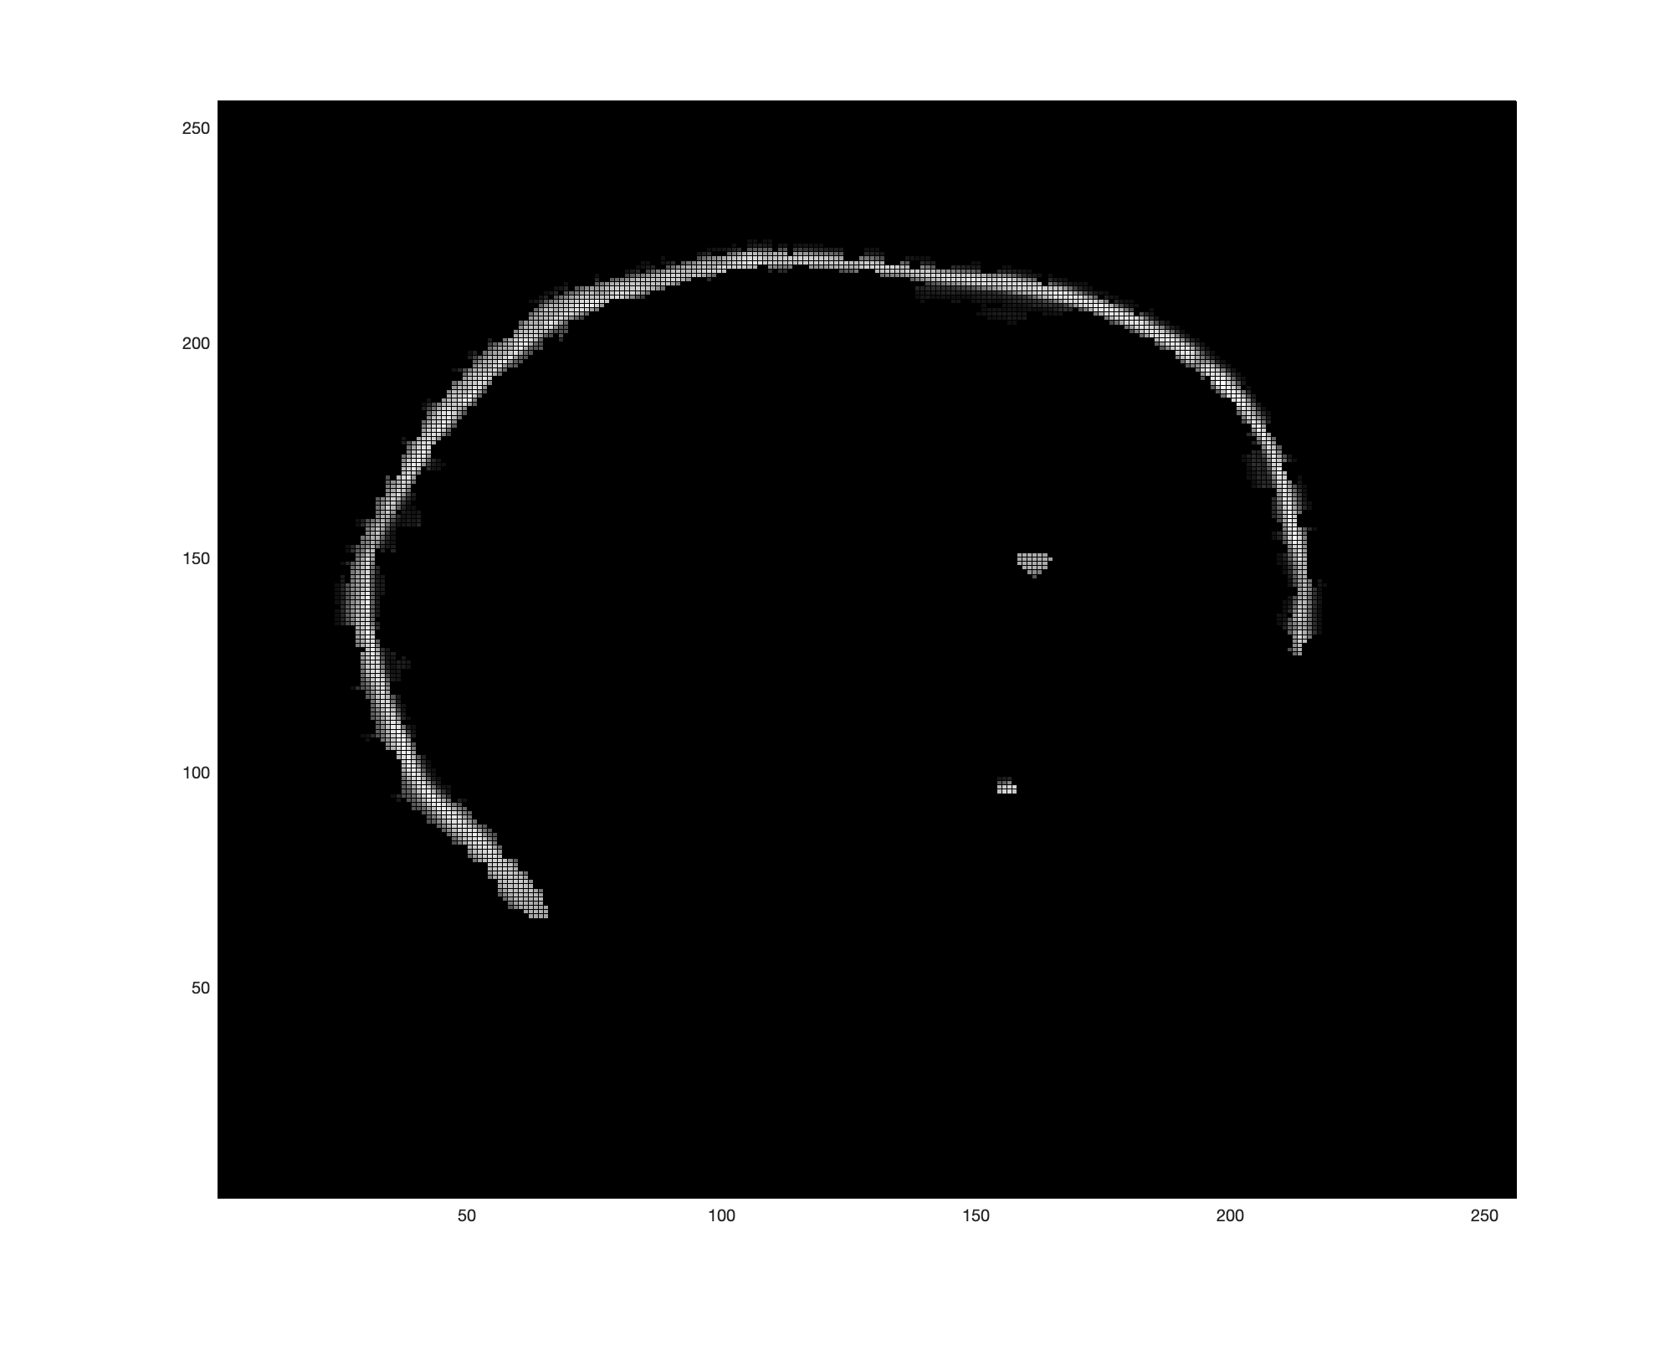
Pruning - Hybrid
After Pruning

Slide 22
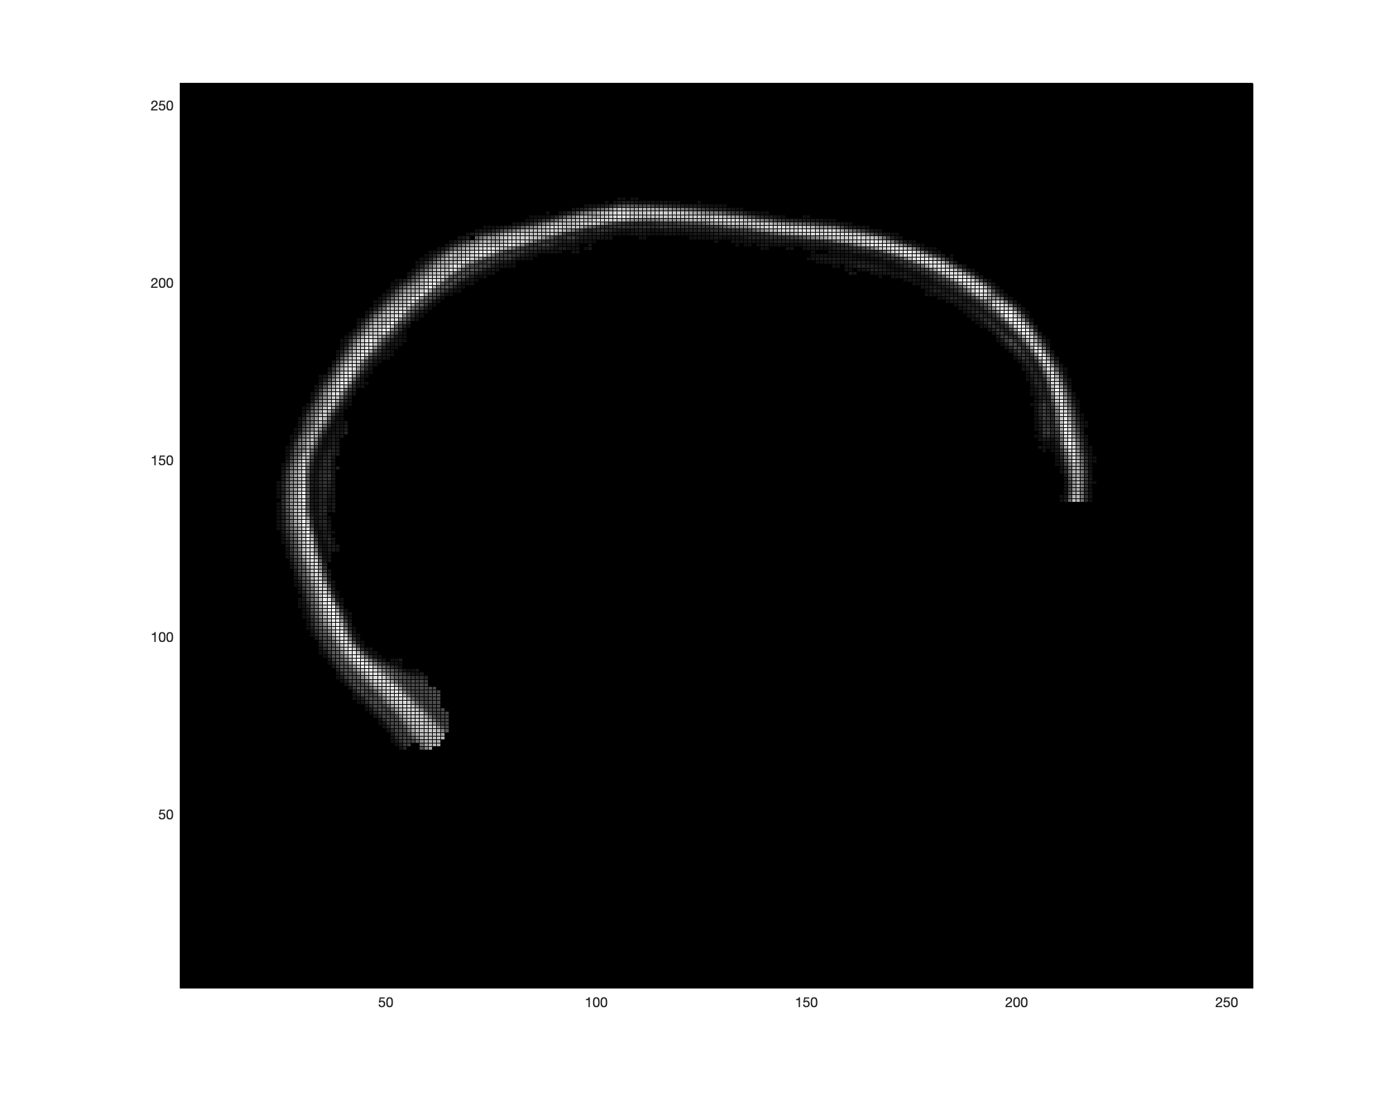
Pruning – Intensity Difference
After Pruning

Slide 23
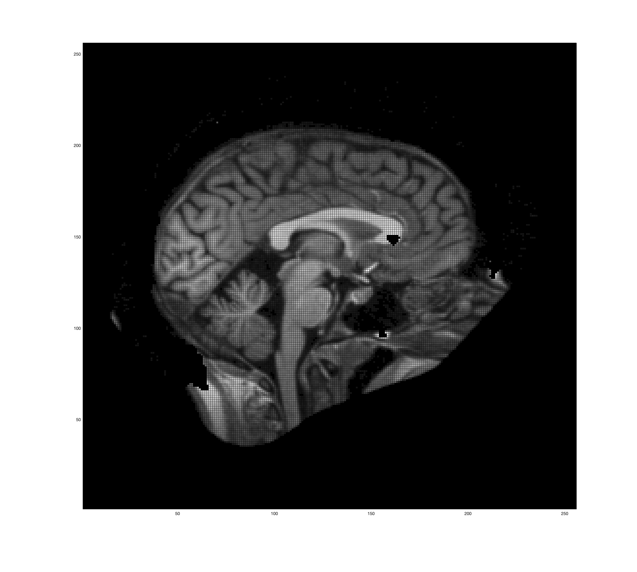
Final Mask
Combined result from hybrid and intensity difference

Slide 24
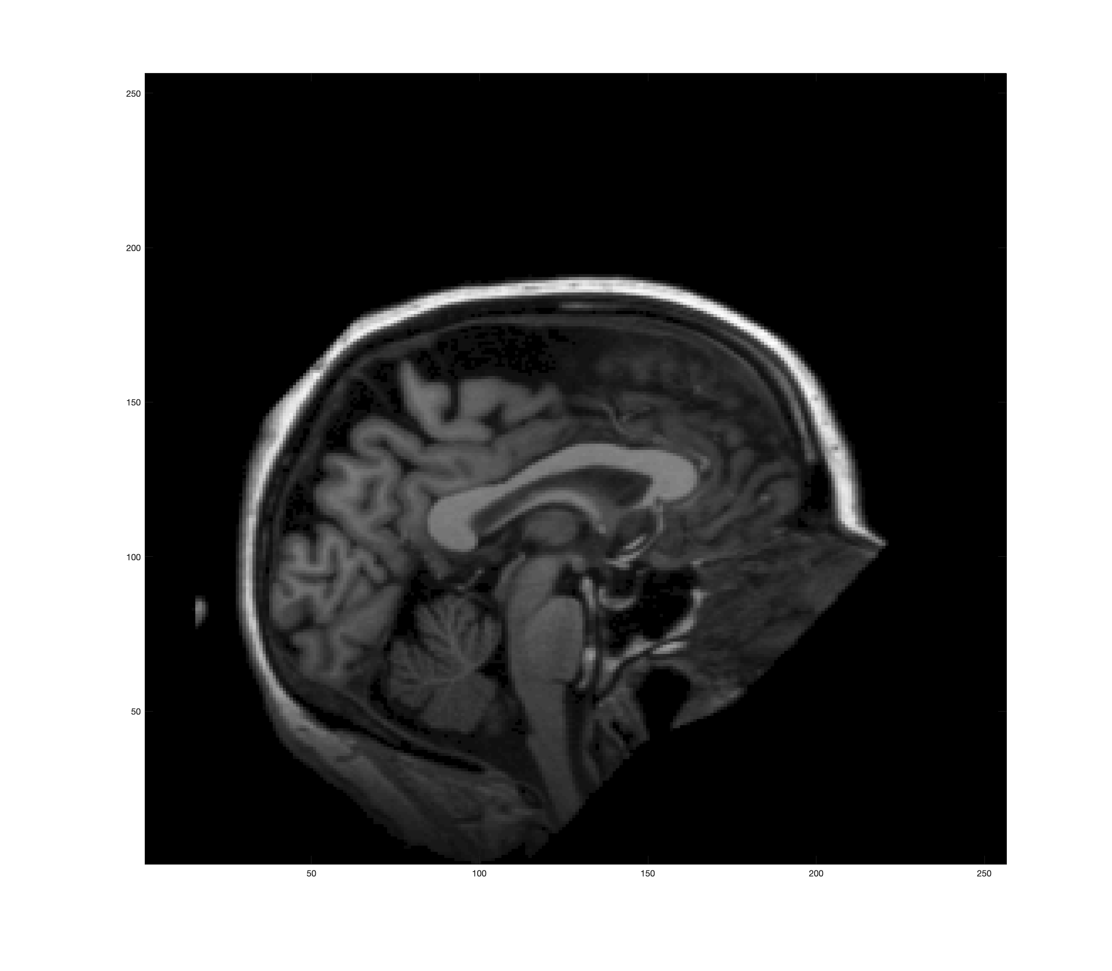
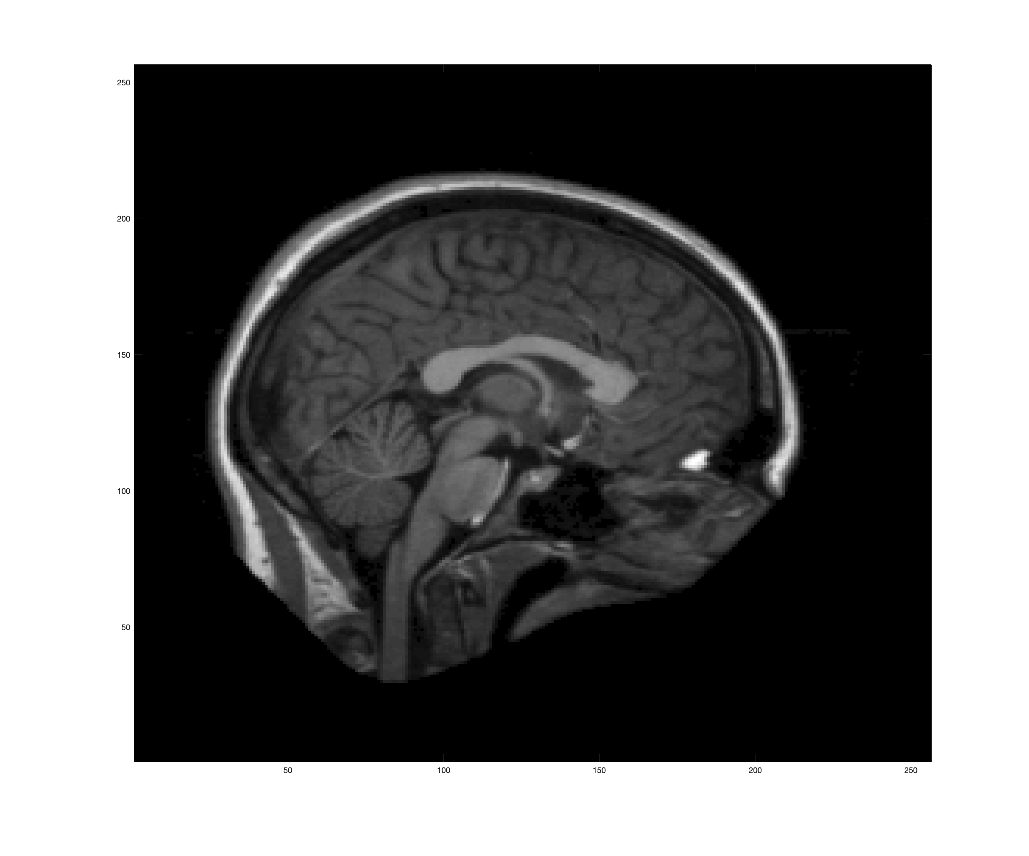
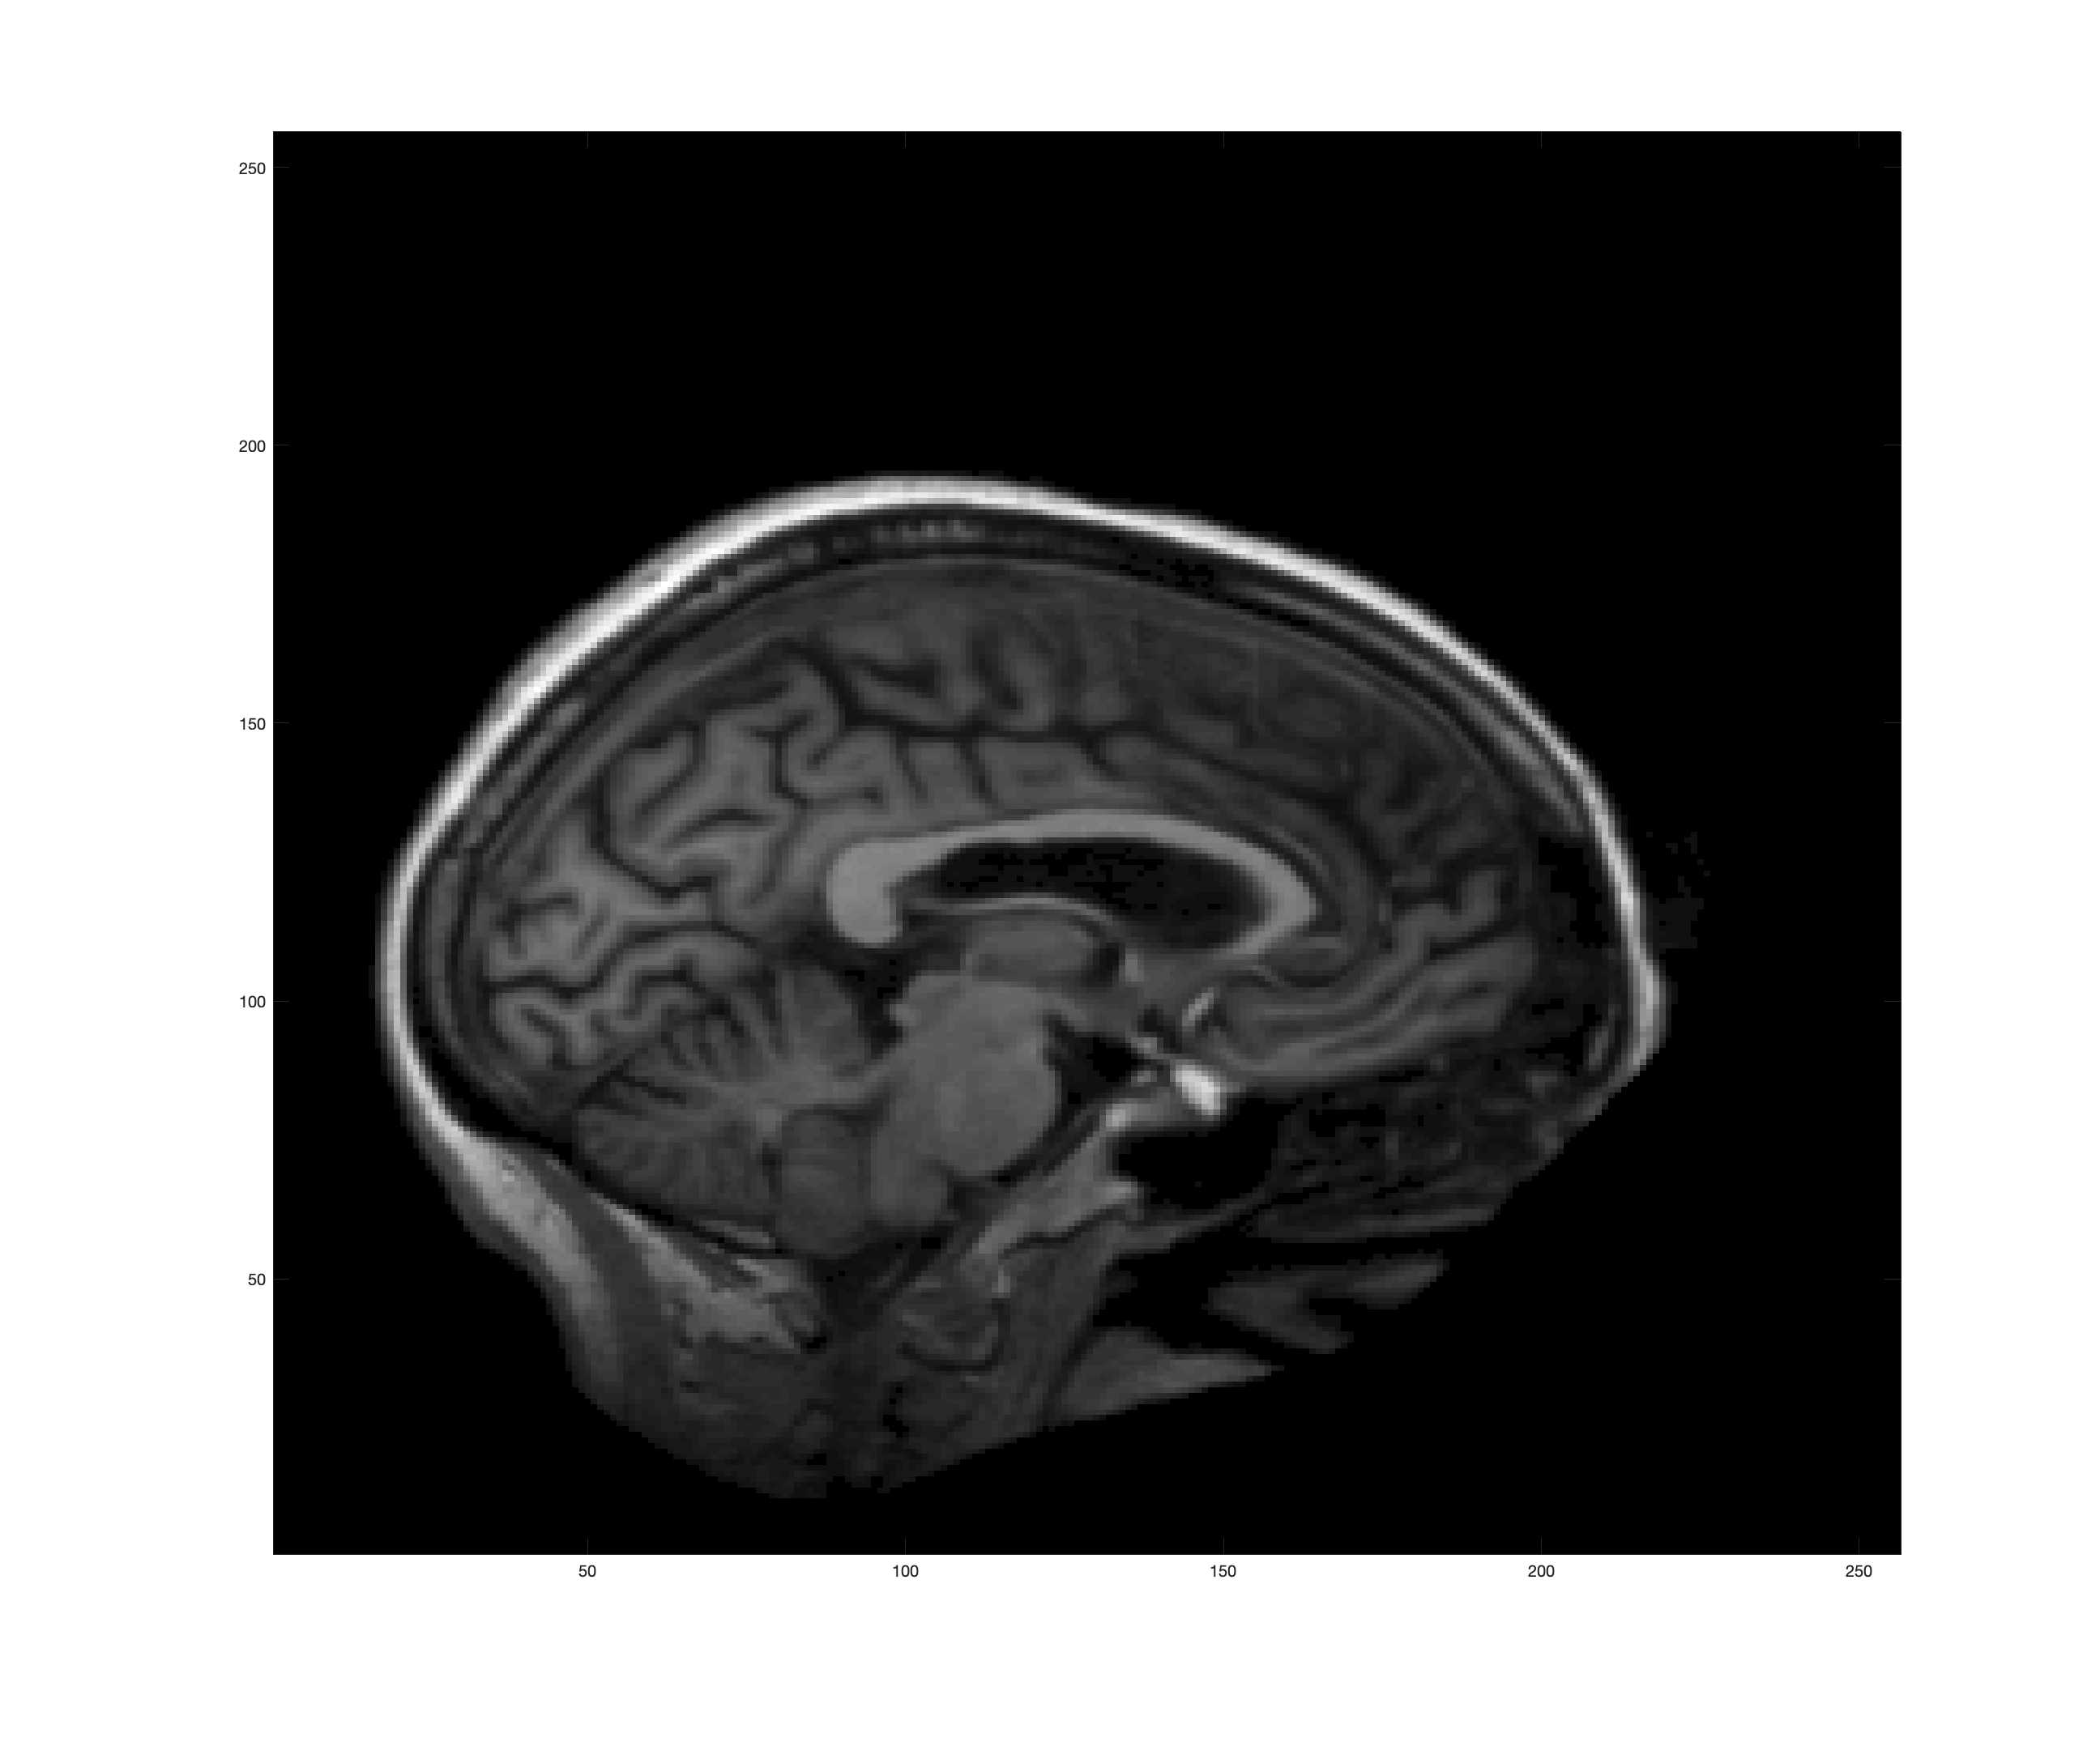
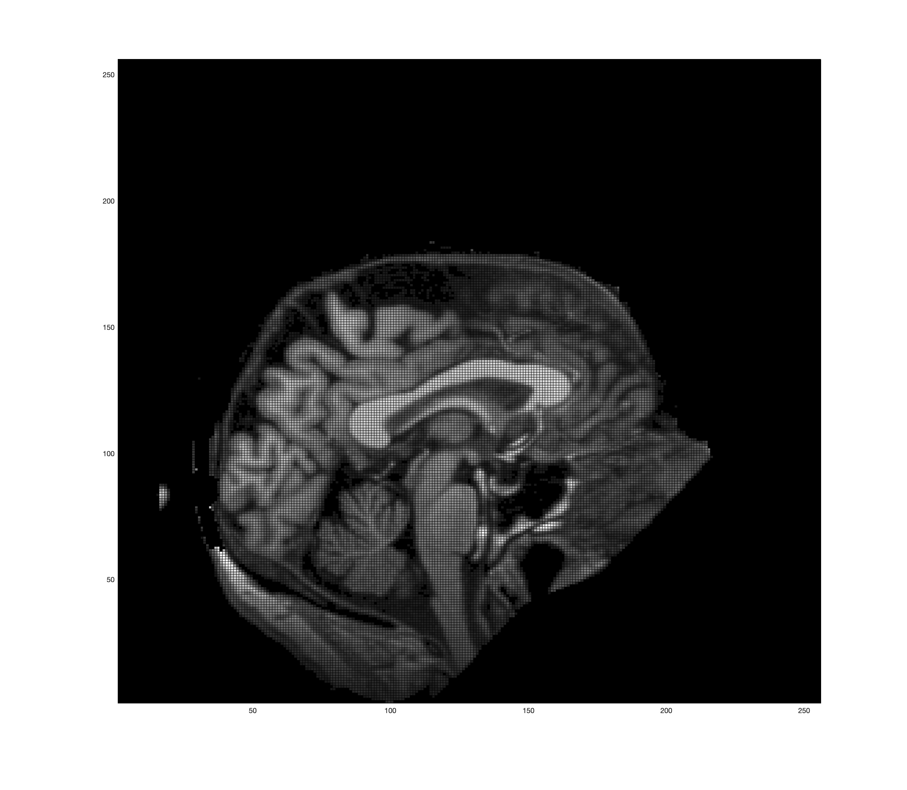
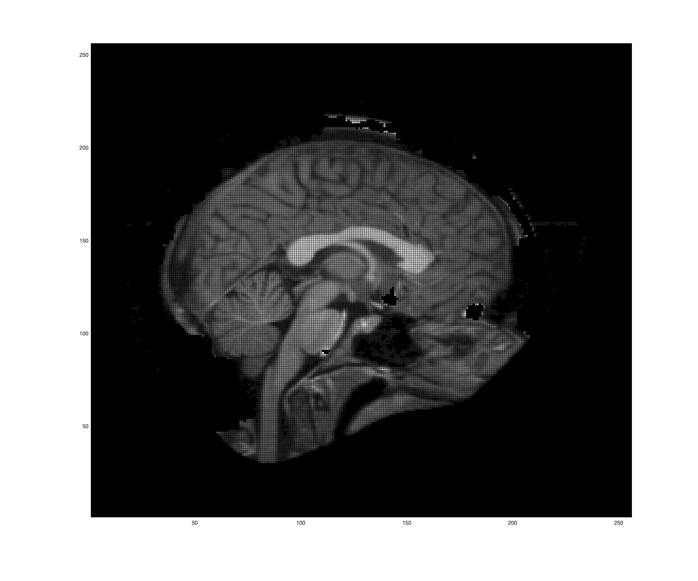
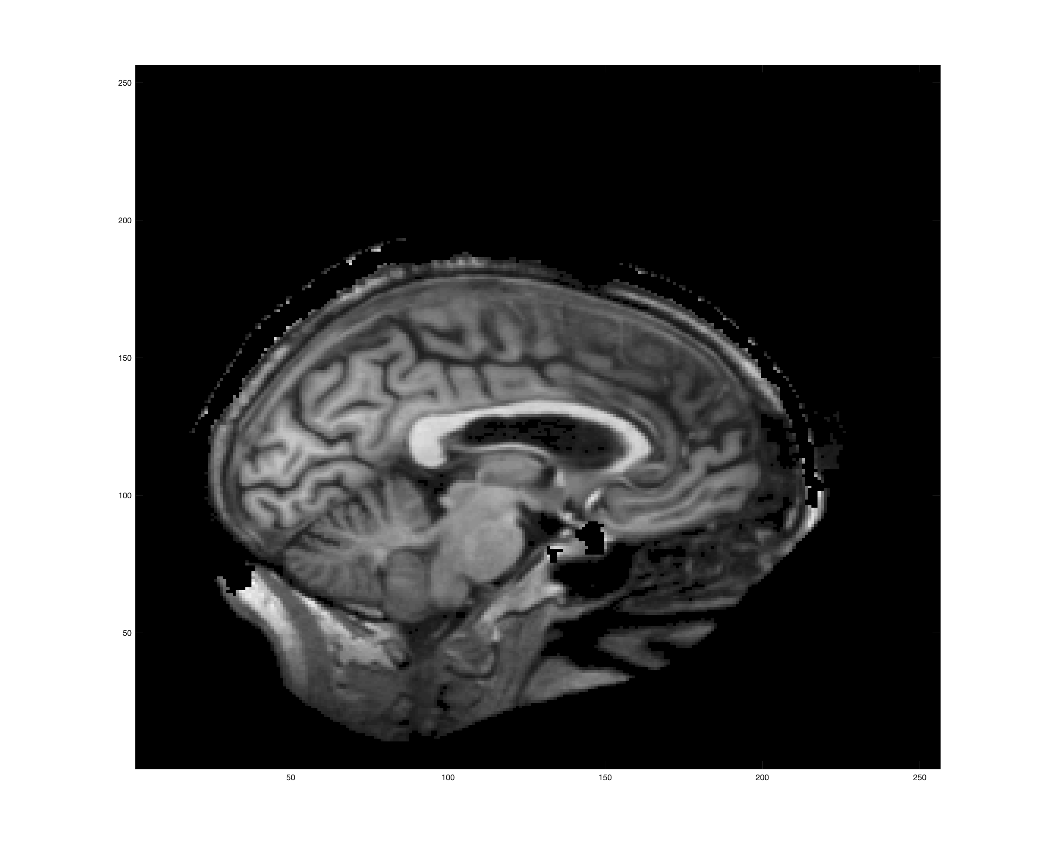
Some Additional Examples

Slide 25
Conclusion
Not a straightforward graph cut problem
No clear boundary edges
Lingering issues
Noise
Smoothness
That pesky corpus callosum
Adding an explicit distance metric will prevent unlikely cut and act as a smoothness term
Postprocessing steps like morphological dilation and erosion could solve issues with holes

